Slide 1

D-instanton in Real Time Dynamics
林树
中山大学
Si-wen Li, SL 1711.06365
Peking U, 11.28

Slide 2
Outline
Instanton in QM and Yang-Mills
Instanton phenomenology in QCD
Holographic D-instanton background
Euclidean correlators
Minkowski correlators (unstable mode)
Summary

Slide 3
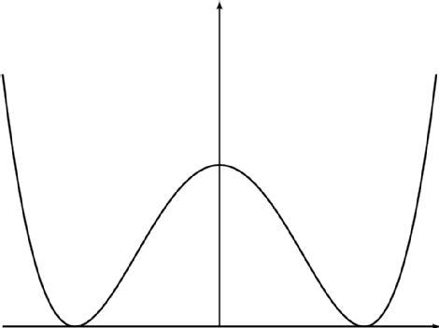
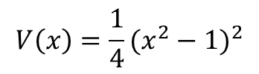
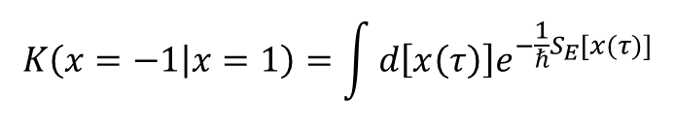

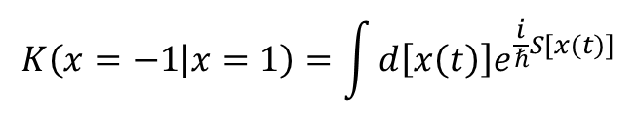
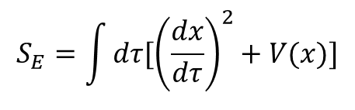


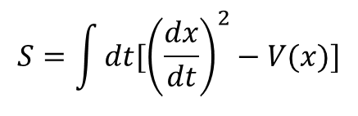
Instanton in Quantum Mechanics
Wick rotation
$$it→τ$$
$$V\left(x\right)=\frac{1}{4}{(x^{2}−1)}^{2}$$
$$V\left(x\right)→−V(x)$$
$$K\left(x=−1 | x=1\right)=\int{d\left[x\left(t\right)\right]e^{\frac{i}{ℏ}S[x(t)]}}$$
$$S=\int{dt[{\left(\frac{dx}{dt}\right)}^{2}−V(x)]}$$
$$it→τ$$
$$K\left(x=−1 | x=1\right)=\int{d\left[x\left(τ\right)\right]e^{−\frac{1}{ℏ}S_{E}[x(τ)]}}$$
$$S_{E}=\int{dτ[{\left(\frac{dx}{dτ}\right)}^{2}+V(x)]}$$
Classical solution only in Euclidean space

Slide 4


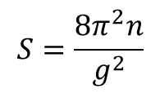

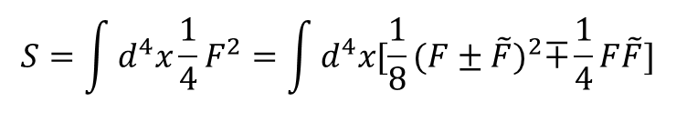
Instanton in Yang-Mills
$$S=\int{d^{4}x\frac{1}{4}F^{2}}=\int{d^{4}x[\frac{1}{8}{(F±\tilde{F})}^{2}∓\frac{1}{4}}F\tilde{F}]$$
$$F±\tilde{F}=0$$
Anti-self dual/self-dual instanton
Solution to Euclidean field equation exists
$$S=\frac{8π^{2}n}{g^{2}}$$
$n$: winding number
Belavin, Polyakov, Schwartz, Tyupkin (1975)
‘t Hooft (1976)
$g$: Yang-Mills coupling
Non-perturbative effect

Slide 5
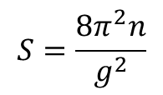

Instanton phenomenology in QCD
$$S=\frac{8π^{2}n}{g^{2}}$$
$$e^{−S}$$
dilute instanton gas: high temperature QCD
Gross, Pisarski, Yaffe RMP (1981)
instanton liquid model: QCD vacuum
instanton picture of chiral symmetry breaking
Schafer, Shuryak RMP (1998)
dyon (monopoles) picture of confinement
Diakonov et al (2004)
Shuryak, Zahed et al (2015)
Poppitz, Schafer, Unsal (2012)
Real time dynamics?

Slide 6




Measure of real time dynamics
Matsubara frequency
Hope: analytic continuation
any $ω$ in upper half plane

Slide 7
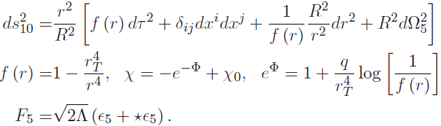
Holographic D-instanton
D3-D-1 branes configuration
contribution of $Φ$ dilaton, $χ$ axion to EOM completely cancel
Instantons do not contribute to stress energy tensor
Liu, Tseytlin NPB (1999)
Ghoroku et al PRD (2005)

Slide 8




5D effective action
$q$: instanton density
Liu, Tseytlin NPB (1999)
Ghoroku et al PRD (2005)

Slide 9
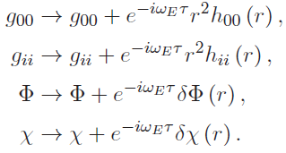



Bulk fields/boundary operators
boundary operators
Homogeneous, isotropic perturbations
In Euclidean background
Near horizon $r=1$, regular solution instead of infalling solution (Minkowski)
$${\sim (r−1)}^{ω_{E}/4}$$
for ${Reω}_{E}>0$
Only two independent regular solutions

Slide 10
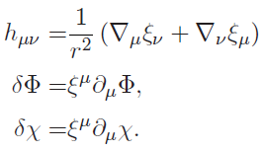
Pure gauge solutions
two independent pure gauge solution
two independent regular solutions + two independent pure gauge solution

Slide 11
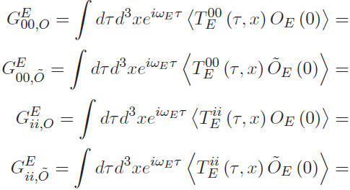

Euclidean cross correlators

Slide 12



Topological constraint

Slide 13







Symmetry constraint
Diffeomorphism invariant
Conformal invariant
Specific to CFT
already obtained from topological constraint

Slide 14





Analytic continuation
$${\sim (r−1)}^{ω_{E}/4}$$
valid for ${Reω}_{E}>0$
$$ω_{E}→−iω$$
valid for $Imω>0$
Domain of retarded correlator
$$ω_{E}$$
$$ω$$

Slide 15
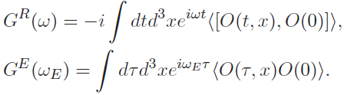


A subtlety in operator definition
Defined with same operator
Euclidean/Minkowski different operators

Slide 16
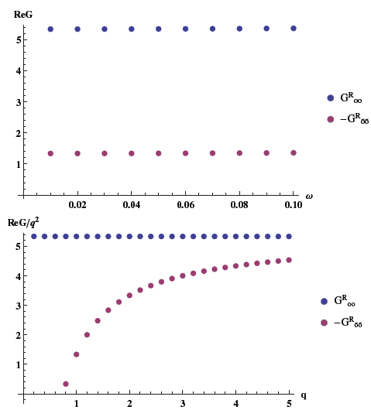








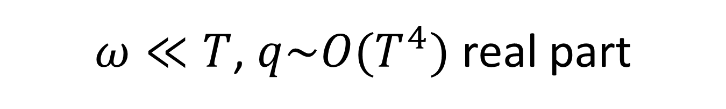
$ω≪T$, $q\sim O(T^{4})$ real part
$q\sim O(T)$, significant instanton density
$$ω≪T$$
$$ReG\sim O(ω^{0})$$
saturation $O(q^{2})$ at large $q$?

Slide 17
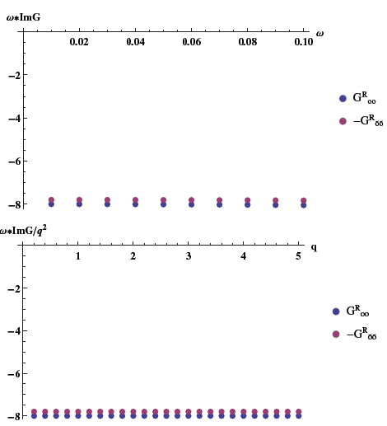


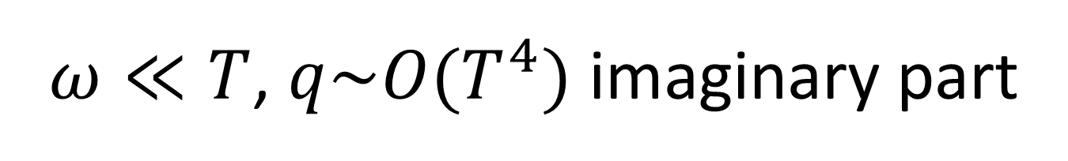
$ω≪T$, $q\sim O(T^{4})$ imaginary part
$$ω≪T$$
$$ImG\sim O(1/ω)$$

Slide 18
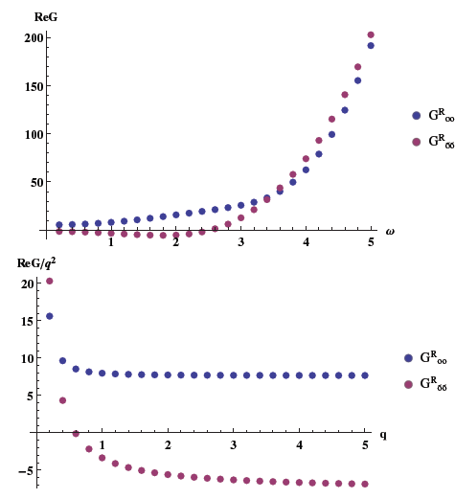





general $ω, q$ real part
approach each other at large $ω$
saturation $O(q^{2})$ at large $q$?

Slide 19
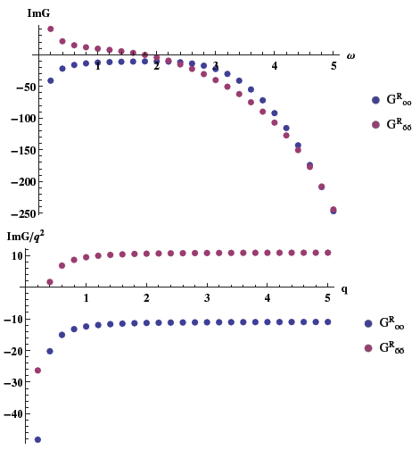



general $ω, q$ imaginary part
approach each other at large $ω$
saturation $O(q^{2})$ at large $q$?

Slide 20

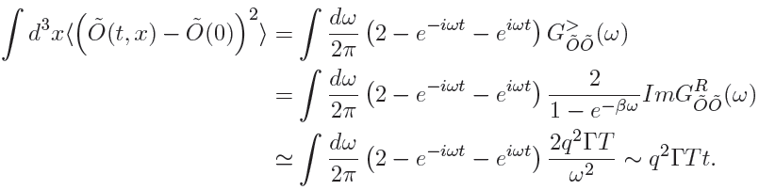

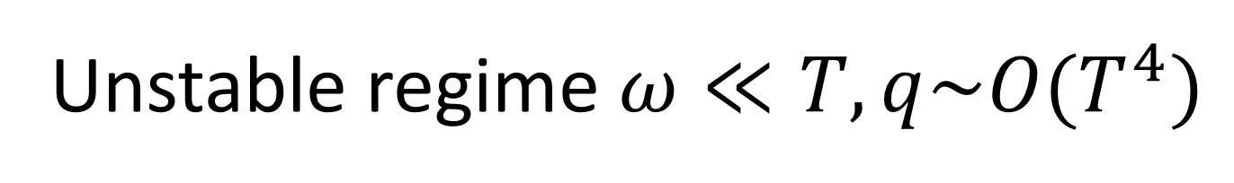


Unstable regime $ω≪T, q\sim O(T^{4})$
$$Γ>0$$
Negative spectral density for $\tilde{O}$ at $ω>0$
Fluctuation of $\tilde{O}$ eventually destroys the instanton background
Lifetime of instanton $1/T$

Slide 21
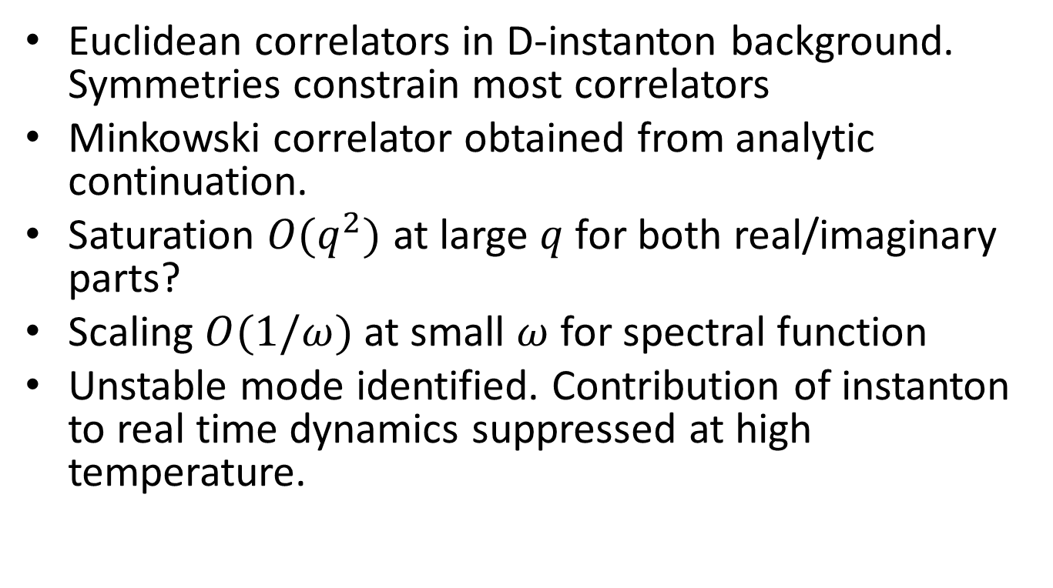
Summary
Euclidean correlators in D-instanton background. Symmetries constrain most correlators
Minkowski correlator obtained from analytic continuation.
Saturation $O(q^{2})$ at large $q$ for both real/imaginary parts?
Scaling $O(1/ω)$ at small $ω$ for spectral function
Unstable mode identified. Contribution of instanton to real time dynamics suppressed at high temperature.

Slide 22
Thank you!

