Slide 1
Explore hadron structure from the first principle lattice QCD calculations
Jianwei Qiu
Brookhaven National Laboratory
Stony Brook University
Based on work done with
Tomomi Ishikawa, Yan-Qing Ma, Shinsuke Yoshida, …
arXiv:1404.6860, 1412.2688, …
Theoretical Physics Seminar, Physics Department, Peking University
Beijing, China, December 23, 2014

Slide 2
Outline
Why should we study hadron structure?
Parton distribution functions (PDFs)
PDFs from lattice QCD calculations
Our proposal
Case study (in both continuous and discretized)
Summary and outlook
Notes:
\frac{\partial f(x,\mu^2)} {\partial\ln\mu^2} = \Sigma_{f'}\, P_{ff'}(x/x') \otimes f'(x',\mu^2)

Slide 3
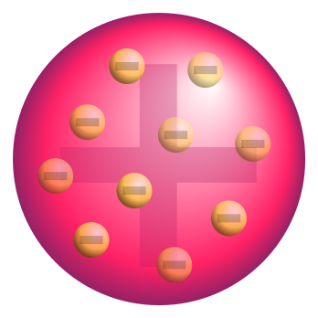
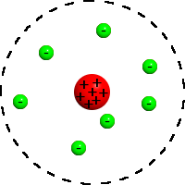
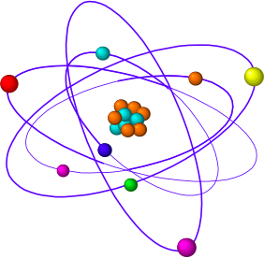
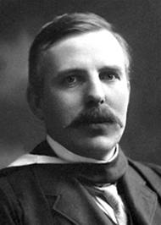
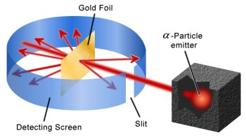
Atomic structure
Rutherford’s experiment – atomic structure (100 years ago):
Atom:
J.J. Thomson’s
plum-pudding model
Rutherford’s
planetary model
Modern model
Quantum orbitals
1911
Discovery of nucleus
A localized
charge/force center
A vast
“open” space
Discovery of
Quantum Mechanics,
and
the Quantum World!
Completely changed our view of the visible world:
Mass by “tiny” nuclei – less than 1 trillionth in volume of an atom
Motion by quantum probability – the quantum world!
Provided infinite opportunities to improve things around us:
Gas, Liquid, Solid, Nano materials, Quantum computing, …

Slide 4
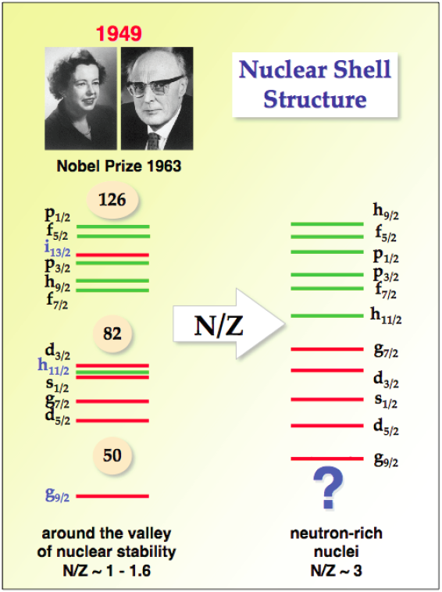
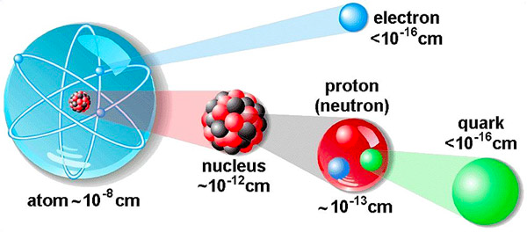
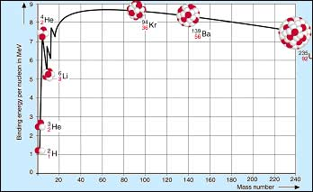
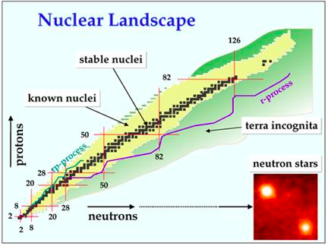
Nuclear structure
Nucleus: Core of visible matter
Nuclear Binding
Energy
Source of nuclear
power
Building blocks – nucleons:
Role of nucleon structure?

Slide 5
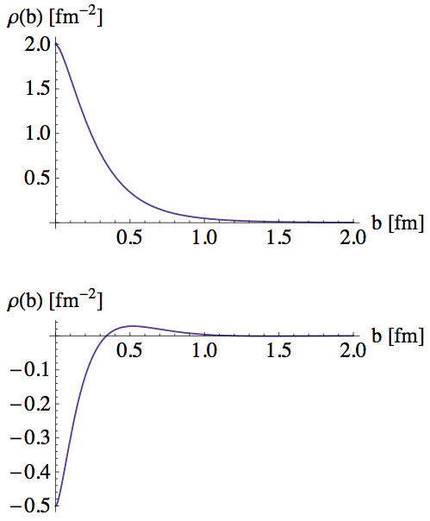
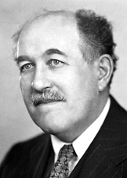
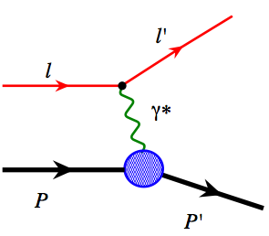
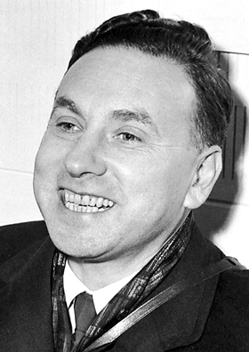
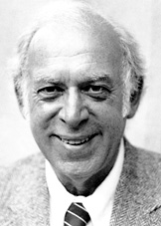
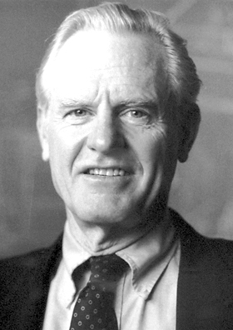
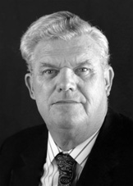
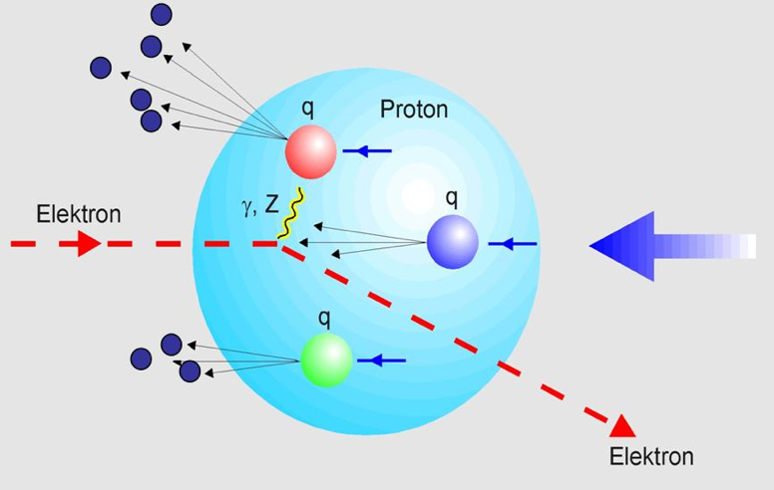
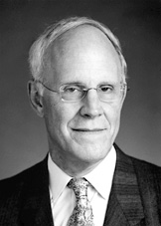
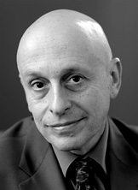
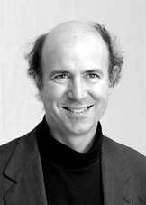
Nucleon is not elementary!
1933: Proton’s magnetic moment
Otto Stern
Proton
Nobel Prize 1943
1960: Elastic e-p scattering
Robert Hofstadter
Nobel Prize 1961
Neutron
Form factors
1969: Deep inelastic e-p scattering
Electric charge distribution
Jerome I. Friedman
Modern “Rutherford’s experiment”
Henry W. Kendall
Richard E. Taylor
Point-like
partons
Nobel Prize 1990
1974: QCD Asymptotic Freedom
David J. Gross
Discovery of QCD
H. David Politzer
Scaling violation
Frank Wilczek
Nobel Prize 2004
Perturbative QCD – theory tool
Factorization - PDFs

Slide 6
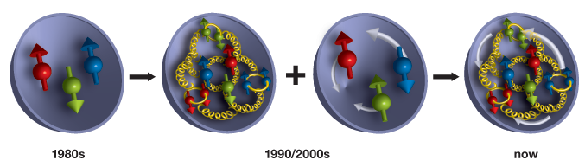
Nucleon’s internal structure
Our understanding of the nucleon evolves
1970s
1980s/2000s
Now
Nucleon is a strongly interacting, relativistic bound state of quarks and gluons
QCD bound states:
Neither quarks nor gluons appear in isolation!
Understanding such systems completely is still beyond the capability of the best minds in the world
The great intellectual challenge:
Probe nucleon structure without “seeing” quarks and gluons?

Slide 7
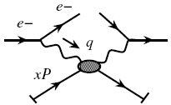
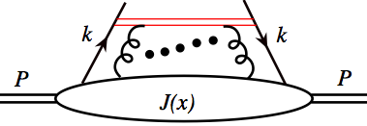
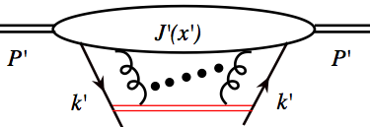
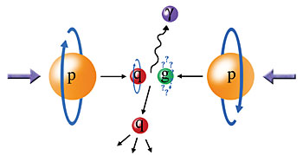
QCD factorization
One hadron:
Hard-part
Probe
Parton-distribution
Structure
Power corrections
Approximation
Two hadrons:
s
Predictive power:
Universal Parton Distributions

Slide 8
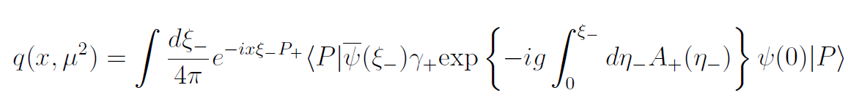
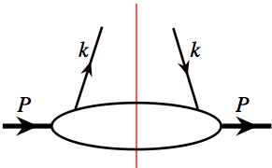
Operator definition of PDFs
Quark distribution (spin-averaged):
Cut-vertex notation:
Independent of hadron momentum P and path direction n
Parton interpretation emerges in n.A = 0 gauge
PDFs are not direct physical observables, such as cross sections!
Notes:
\longleftarrow
\frac{\gamma\cdot n}{2P\cdot n}\,
\delta\left(x-\frac{k\cdot n}{P\cdot n}\right) \,
\frac{d^4k}{(2\pi)^4}

Slide 9
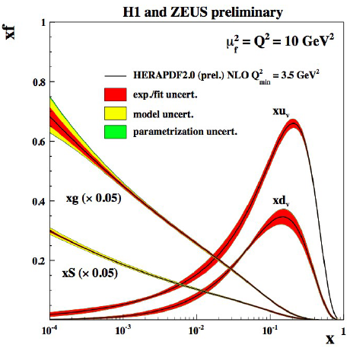
Global QCD analyses – a successful story
World data with “Q” > 2 GeV
+ Factorization:
DIS:
H-H:
+ DGLAP Evolution:
Notes:
\frac{\partial f(x,\mu^2)} {\partial\ln\mu^2} = \Sigma_{f'}\, P_{ff'}(x/x') \otimes f'(x',\mu^2)

Slide 10
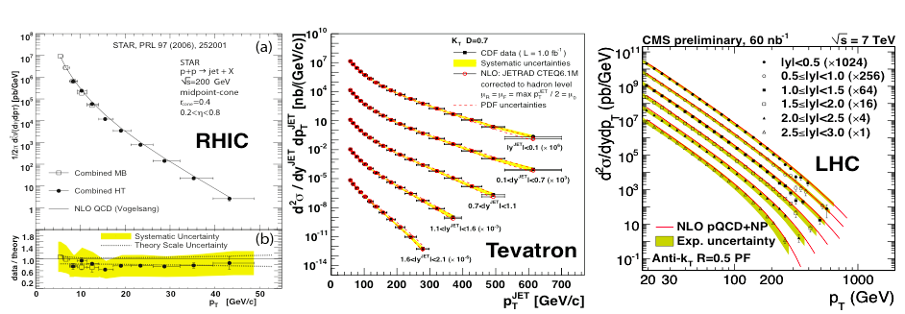
Global QCD analyses – a successful story
World data with “Q” > 2 GeV
+ Factorization:
DIS:
H-H:
+ DGLAP Evolution:
Notes:
\frac{\partial f(x,\mu^2)} {\partial\ln\mu^2} = \Sigma_{f'}\, P_{ff'}(x/x') \otimes f'(x',\mu^2)

Slide 11
Global QCD analysis – the machinery
Input PDFs at Q₀
Vary
Minimize Chi²
DGLAP
QCD calculation
Comparison with Data
at various x and Q
at Q>Q₀
Procedure: Iterate to find the best set of {a_{j}} for the input DPFs

Slide 12
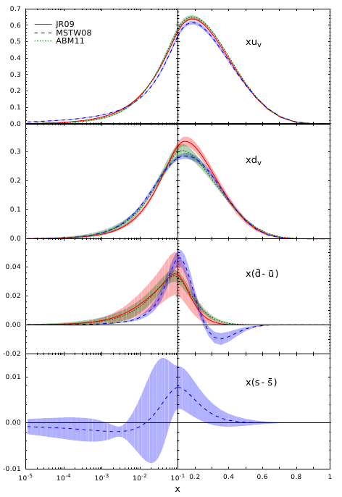
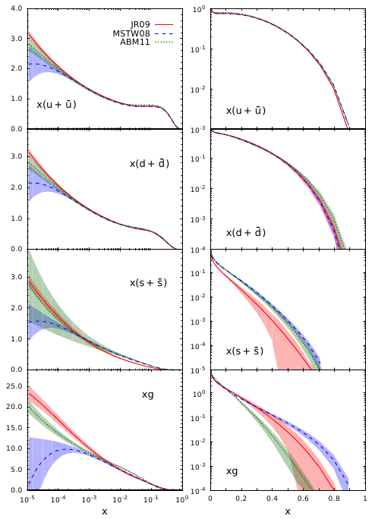
Uncertainties of PDFs
“singlet”
sector
“non-singlet”
sector

Slide 13
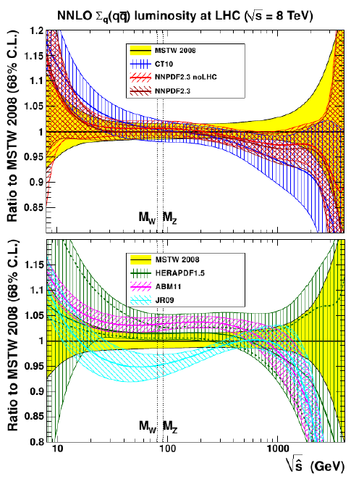
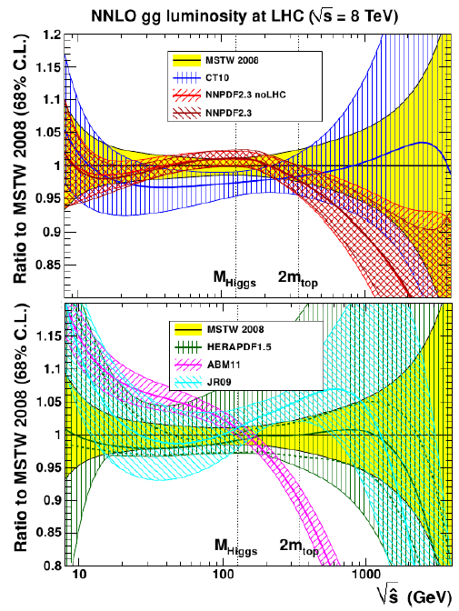
Partonic luminosities
q - qbar
g - g

Slide 14
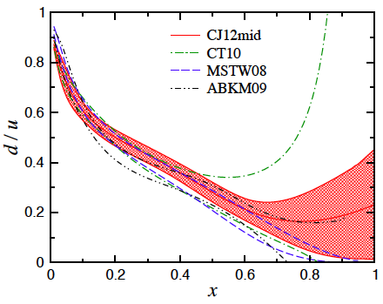
PDFs at large x
Testing ground for hadron structure at x ➔1:
SU(6) Spin-flavor
symmetry
Scalar diquark
dominance
pQCD power
counting
Local quark-hadron
duality
Notes:
d/u \to ½
d/u &\to \frac{4\mu_n^2/\mu_p^2 - 1}{4-\mu_n^2/\mu_p^2} \\
&\approx \ 0.42

Slide 15
PDFs at large x
Testing ground for hadron structure at x ➔1:
SU(6) Spin-flavor
symmetry
Scalar diquark
dominance
pQCD power
counting
Local quark-hadron
duality
Can lattice QCD help?
Notes:
d/u \to ½
d/u &\to \frac{4\mu_n^2/\mu_p^2 - 1}{4-\mu_n^2/\mu_p^2} \\
&\approx \ 0.42
\Delta u/u &\to \ 2/3\\
\Delta d/d &\to -1/3

Slide 16
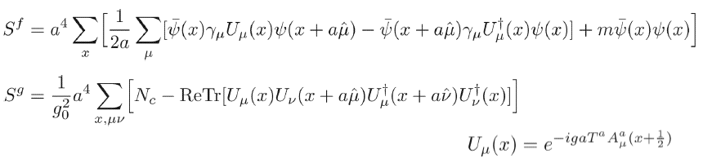

Lattice QCD
Formulated in the discretized Euclidean space:
Boundary condition is imposed on each field in finite volume:
Momentum space is restricted in finite Brillouin zone:
Lattice QCD is an Ultra-Violet (UV) finite theory
Lattice action is not unique, above action is the simplest one!
Many implementations were proposed to reduce the discretization error
Notes:
\frac{\partial f(x,\mu^2)} {\partial\ln\mu^2} = \Sigma_{f'}\, P_{ff'}(x/x') \otimes f'(x',\mu^2)

Slide 17
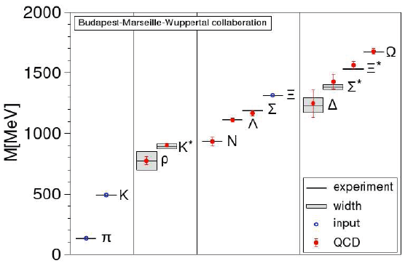
Lattice QCD
The main non-perturbative approach to solve QCD
Hadron mass spectrum:
Predict the spectrum
with limited inputs
An intrinsically Euclidean approach:
Lattice “time” is Euclidean:
No direct implementation of physical time
Cannot calculate PDFs directly, whose operators
are time-dependent

Slide 18
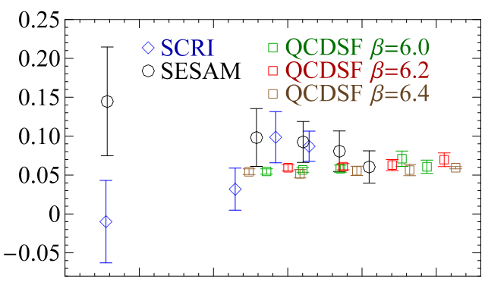
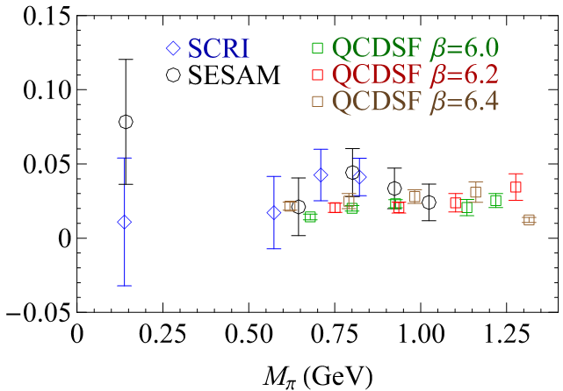
PDFs from lattice QCD
Moments of PDFs – matrix elements of local operators
Works, but, hard and limited moments:
Dolgov et al., hep-lat/0201021 Gockeler et al., hep-ph/0410187
Notes:
\langle x^n(\mu^2) \rangle_q \equiv
\int_0^1 dx\, x^{n}\, q(x,\mu^2)
\langle x^3 \rangle_q

Slide 19
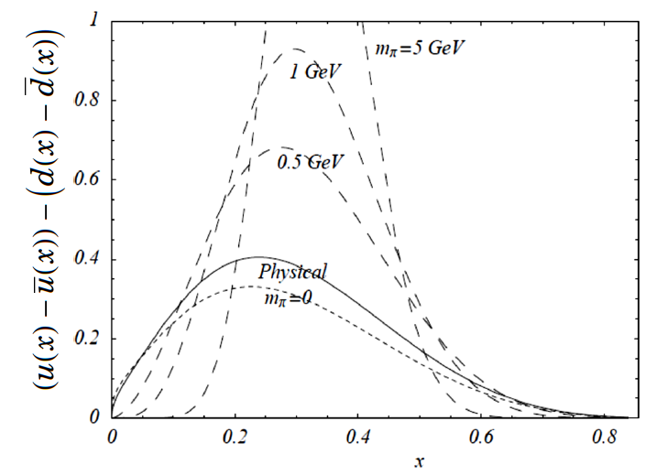
PDFs from lattice
How to get x-dependent PDFs with a limited moments?
Assume a smooth functional form with some parameters
Fix the parameters with the lattice calculated moments
W. Dermold et al., Eur.Phys.J.direct C3 (2001) 1-15
Cannot distinguish valence quark contribution from sea quarks
Notes:
\langle x^n(\mu^2) \rangle_q \equiv
\int_0^1 dx\, x^{n}\, q(x,\mu^2)
\langle x^3 \rangle_q

Slide 20
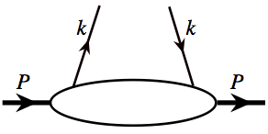
Ji’s new idea
Ji, arXiv:1305. 1539
“Quasi” quark distribution (spin-averaged):
“Cut-vertex” notation:
Features:
Quark fields separated along the z-direction – not boost invariant!
Perturbatively UV power divergent: with
This distribution can be calculated using standard lattice method
quasi-PDFs ➔ normal PDFs when P_{z} ➔∞
Proposed Matching:
Notes:
\longleftarrow
\frac{\gamma\cdot n_z}{2P\cdot n_z}\,
\delta\left(x-\frac{k\cdot n_z}{P\cdot n_z}\right) \,
\frac{d^4k}{(2\pi)^4}

Slide 21
“Quasi-PDFs” have no parton interpretation
Normal PDFs conserve parton momentum:
Energy-momentum
tensor
“Quasi-PDFs” do not conserve “parton” momentum:
Note: “Quasi-PDFs” are not boost invariant
Notes:
M = \sum_q\left[
\int_0^1 dx\, x f_{q}(x) +
\int_0^1 dx\, x f_{\bar{q}}(x)\right]
+\int_0^1 dx\, x f_{g}(x)

Slide 22
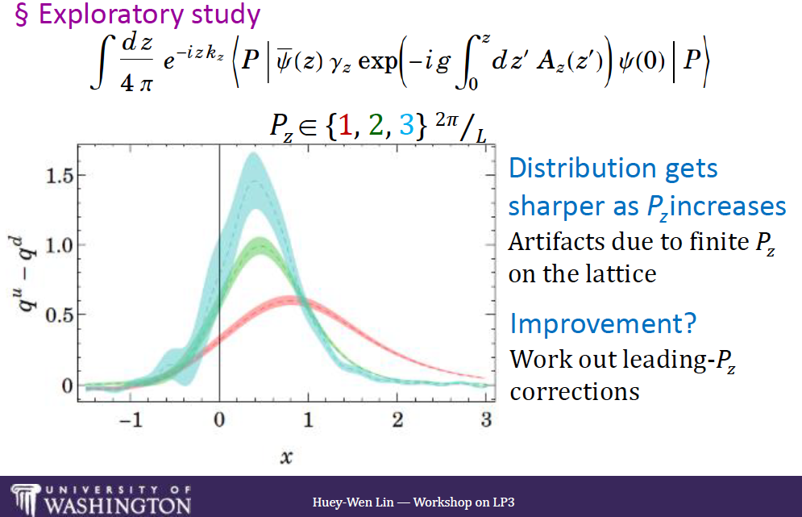
The first try
Lin et al., arXiv:1402.1462
Ji, arXiv:1305. 1539
Notes:
\longleftarrow
\frac{\gamma\cdot n_z}{2P\cdot n_z}\,
\delta\left(x-\frac{k\cdot n_z}{P\cdot n_z}\right) \,
\frac{d^4k}{(2\pi)^4}

Slide 23
Our observation
Lattice QCD calculates “single” hadron matrix elements:
With an Euclidean time
Collinear divergence (CO) from the region when k_{T} ➔0:
Same CO divergence regardless
Minkowski or Euclidean time
PDFs should cover all leading power CO divergences of
“Single” hadron matrix elements with a large momentum scale

Slide 24
Our proposal – a “slightly” modified idea
Ma and Qiu,
arXiv:1404.6860
1412.2688
Not try to go to the light-cone – Less ambiguous:
– Lattice “cross sections” @ Finite + QCD factorization
Identify single-hadron “cross sections”, calculable in Lattice QCD,
and factorizable into a convolution with normal PDFs
(1)
e.g.
Ji’s quasi-PDFs
Need a large scale if is made of conserved currents
KEY: all order factorization into the Normal PDFs with
Calculate the Lattice “cross sections” in Lattice QCD – the LHS of (1)
“Measure” high energy scattering cross sections on Lattice
Global analysis of Lattice “cross sections” – to extract the normal PDFs
Note:
are finite parameters: “rapidity”, “hard scale”, …
Notes:
\widetilde{\sigma}^{i}(\tilde{x},\tilde{Q}^2,\{\tilde{\nu}\})
= \Sigma_{f}\, C^{i}_f(\tilde{x}/x,\mu^2/\tilde{Q}^2,\{\tilde{\nu}\}) \otimes f(x,\mu^2)
+ {\cal O}\left[\frac{1}{\tilde{Q}^\alpha}\right]
\frac{\partial\widetilde{\sigma}_{i}(\tilde{x},\tilde{\mu}^2,\{\tilde{\nu}\})}{\partial\ln\tilde{\mu}^2}
= \Sigma_{f}\, {\cal D}_{if}(\tilde{x}/x,\mu^2/\tilde{\mu}^2,\{\tilde{\nu}\}) \otimes f(x,\mu^2)
+ {\cal O}\left[\frac{1}{\tilde{\mu}^\alpha}\right]
\widetilde{\sigma}^{i}(\tilde{x},\tilde{\mu}^2,P_z)\ \Rightarrow \
\widetilde{f}^{i}(\tilde{x}=k_z/P_z,\tilde{\mu}^2,P_z)\
\widetilde{\sigma}^{i}(\tilde{x},\tilde{\mu}^2,P_z)\ \propto \
\langle P_z|{\cal O}(\psi, A)|P_z\rangle
\tilde{x}, \tilde{\mu}, \{\tilde{\nu}\}

Slide 25

Lattice “cross section”
Definition:
Calculable in lattice QCD with an Euclidean time, “E”
It is infrared (IR) safe, calculated in lattice perturbation theory
All CO divergences of its continuum limit ( ) can be factorized into the normal PDFs with perturbatively calculable hard coefficients
Its continuum limit is UV renormalizable
“Collision energy” “rapidity”
“Hard momentum transfer”
UV renormalization:
No UVCT needed if is made of conserved currents
The quasi-PDFs are not made of conserved currents – UVCT needed
Factorization – separate UV renormalization:
Notes:
\widetilde{\sigma}(\tilde{x},\tilde{\mu}^2,\{\tilde{\nu}\}) = \int\, \frac{dy_z}{2\pi} e^{i\tilde{x}P_z y_z} \langle P| \widetilde{\cal O}^{\alpha_1 ...\alpha_n}(y_z) |P\rangle
\widetilde{\sigma}(\tilde{x},k_\perp, \tilde{\mu}^2,\{\tilde{\nu}\}) = \int\, \frac{dy_z d^2k_\perp}{(2\pi)^3} e^{i\tilde{x}P_z y_z} e^{ik_\perp\cdot y_\perp} \langle P| \widetilde{\cal O}^{\alpha_1 ...\alpha_n}(y_z,y_\perp) |P\rangle
\widetilde{\sigma}^{\rm Lat}_{E}(\tilde{x},1/a,P_z) \propto {\rm F.T.\, of}\ \langle P_z| {\cal O}(\overline{\psi},\psi,A)|P_z\rangle

Slide 26
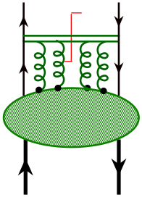
Case study – factorization of quasi-PDFs
The “Quasi-quark” distribution, as an example:
Ma and Qiu,
arXiv:1404.6860
1412.2688
Feynman diagram representation:
Like PDFs, it is IR finite
Unlike PDFs, it is power UV divergent (linear)
Potential trouble! - mixing with the Log UV of PDFs?
CO divergence is the same as that of normal PDFs
Show to all orders in perturbation theory
Notes:
\tilde{q}(\tilde{x},\tilde{\mu}^2,P_z) = \int \frac{dy_z}{4\pi} e^{i\tilde{x}P_z y_z} \langle P| \overline{\psi}(y_z)
\gamma_z {\rm exp}\left\{ -ig\int_0^{y_z} dy_z' A_z(y_z’) \right\} \psi(0) |P\rangle
\longleftarrow\ \frac{\gamma_z}{2P_z}\, \delta\left(\tilde{x}-\frac{k_z}{P_z}\right)
k^2 \leq \tilde{\mu}^2\ (\gg \Lambda_{\rm QCD}^2)

Slide 27
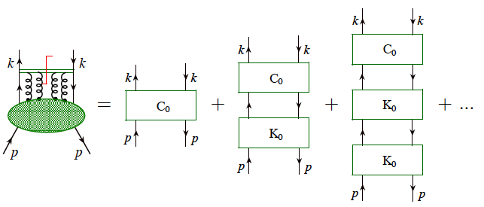
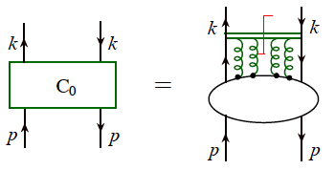
All order QCD factorization of CO divergence
Ma and Qiu, arXiv:1404.6860
Generalized ladder decomposition in a physical gauge
Mueller, PRD 1974
2PI kernels
Only process dependence:
2PI are finite in a physical gauge for fixed k and p:
Ellis, Georgi, Machacek, Politzer, Ross, 1978, 1979
Notes:
\tilde{q}(\tilde{x},\tilde{\mu}^2,P_z) = \int \frac{dy_z}{4\pi} e^{i\tilde{x}P_z y_z} \langle P| \overline{\psi}(y_z)
\gamma_z {\rm exp}\left\{ -ig\int_0^{y_z} dy_z' A_z(y_z’) \right\} \psi(0) |P\rangle
\longleftarrow\ \frac{\gamma_z}{2P_z}\, \delta\left(\tilde{x}-\frac{k_z}{P_z}\right)
k^2 \leq \tilde{\mu}^2\ (\gg \Lambda_{\rm QCD}^2)

Slide 28
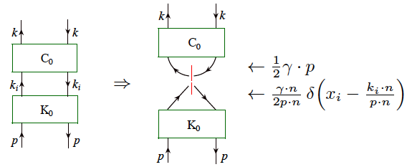
All order QCD factorization of CO divergence
2PI kernels – Diagrams:
Ordering in virtuality:
+ power suppressed
Cut-vertex for normal quark distribution
Logarithmic UV and CO divergence
Renormalized kernel - parton PDF:
Notes:
\tilde{q}(\tilde{x},\tilde{\mu}^2,P_z) = \int \frac{dy_z}{4\pi} e^{i\tilde{x}P_z y_z} \langle P| \overline{\psi}(y_z)
\gamma_z {\rm exp}\left\{ -ig\int_0^{y_z} dy_z' A_z(y_z’) \right\} \psi(0) |P\rangle
\longleftarrow\ \frac{\gamma_z}{2P_z}\, \delta\left(\tilde{x}-\frac{k_z}{P_z}\right)
k^2 \leq \tilde{\mu}^2\ (\gg \Lambda_{\rm QCD}^2)

Slide 29
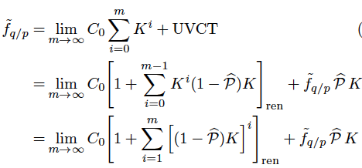


All order QCD factorization of CO divergence
Projection operator for CO divergence:
Pick up the logarithmic CO divergence of K
Factorization of CO divergence:
Normal Quark
distribution
CO divergence free
All CO divergence of
quasi-quark distribution
UV finite?
Notes:
\tilde{q}(\tilde{x},\tilde{\mu}^2,P_z) = \int \frac{dy_z}{4\pi} e^{i\tilde{x}P_z y_z} \langle P| \overline{\psi}(y_z)
\gamma_z {\rm exp}\left\{ -ig\int_0^{y_z} dy_z' A_z(y_z’) \right\} \psi(0) |P\rangle
\longleftarrow\ \frac{\gamma_z}{2P_z}\, \delta\left(\tilde{x}-\frac{k_z}{P_z}\right)
k^2 \leq \tilde{\mu}^2\ (\gg \Lambda_{\rm QCD}^2)

Slide 30
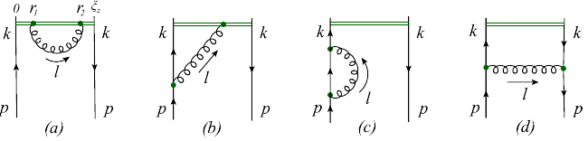
UV renormalization
Ma and Qiu, arXiv:1404.6860, …
UV divergences (difference in gauge link):
Renormalization:
In coordinate space:
ξ_{z}
Independence!
Power divergence:
Diagram (a) – independent of ξ_{z}
Removed by “mass” renormalization of a test particle – the gauge link
Left-over log divergence:
Dotsenko and Vergeles NPB, 1980)
Dimensional regularization – ξ_{z} independence of 1/ε – finite CTs
Log(ξ_{z}) – term:
Artifact of dimensional regularization
Notes:
\widetilde{d}^{\alpha\beta}(l)
=-g^{\alpha\beta}
+ \frac{l^\alpha\, n_z^\beta + n_z^\alpha\, l^\beta}{l\cdot n_z}
-\frac{n_z^2}{(\l\cdot n_z)^2}\,
l^\alpha l^\beta

Slide 31


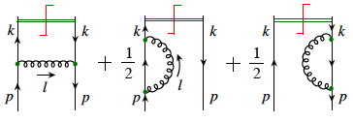
One-loop example: quark ➔quark
Ma and Qiu, arXiv:1404.6860
Expand the factorization formula:
Feynman diagrams:
Same diagrams for both
and
But, in different gauge
Gauge choice:
Gluon propagator:
with
Notes:
\widetilde{d}^{\alpha\beta}(l)
=-g^{\alpha\beta}
+ \frac{l^\alpha\, n_z^\beta + n_z^\alpha\, l^\beta}{l\cdot n_z}
-\frac{n_z^2}{(\l\cdot n_z)^2}\,
l^\alpha l^\beta

Slide 32




One-loop “quasi-quark” distribution in a quark
Ma and Qiu, arXiv:1404.6860
Real + virtual contribution:
where
Cancelation of CO divergence:
Only the first term is CO divergent for 0 < y < 1, which is the same
as the divergence of the normal quark distribution – necessary!
UV renormalization:
Different treatment for the upper limit of integration - “scheme”
Here, a UV cutoff is used – other scheme is discussed in the paper
Notes:
\widetilde{R} = C_F \frac{\alpha_s}{2\pi}\int \frac{2\, d^{D-2} l_\perp}{(2\pi)^{D-3}\, l_\perp^2}\int dl_z\, \delta\left(1-x-\frac{l_z}{P_z}\right)
\times\left[ \frac{1-l_z/P_z}{l_z^2}\, \frac{l_\perp^2}{2\sqrt{l_\perp^2 + l_z^2}}
+\left(1-\frac{l_z}{P_z}+\frac{1-\epsilon}{2} \frac{l_z^2}{P_z^2}\right)
\frac{\sqrt{l_\perp^2+l_z^2}+l_z} {l_z\sqrt{l_\perp^2+l_z^2}}\right]

Slide 33





One-loop coefficient functions
Ma and Qiu, arXiv:1404.6860
MS scheme for :
where
Generalized “+” description:
For a testing function
Explicit verification of the factorization at one-loop:
Coefficient functions for all partonic channels are IR safe and finite!
Notes:
\widetilde{R} = C_F \frac{\alpha_s}{2\pi}\int \frac{2\, d^{D-2} l_\perp}{(2\pi)^{D-3}\, l_\perp^2}\int dl_z\, \delta\left(1-x-\frac{l_z}{P_z}\right)
\times\left[ \frac{1-l_z/P_z}{l_z^2}\, \frac{l_\perp^2}{2\sqrt{l_\perp^2 + l_z^2}}
+\left(1-\frac{l_z}{P_z}+\frac{1-\epsilon}{2} \frac{l_z^2}{P_z^2}\right)
\frac{\sqrt{l_\perp^2+l_z^2}+l_z} {l_z\sqrt{l_\perp^2+l_z^2}}\right]

Slide 34
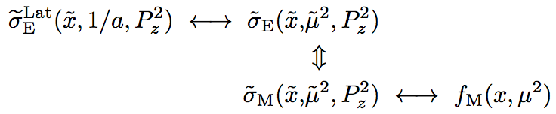
From Lattice “x-sections” to PDFs
BNL – RBRC efforts:
Case study
Factorization of
Quasi-PDFs
Ma, et al.
On-going
Lattice perturbation theory
To do list:
Lattice perturbation theory
UV finite – “lattice renormalization (cutoff or other renormalization)
Need to verify that it is IR safe
Need to show indeed that CO divergence is the same as PDFs
Notes:
M = \sum_q\left[
\int_0^1 dx\, x f_{q}(x) +
\int_0^1 dx\, x f_{\bar{q}}(x)\right]
+\int_0^1 dx\, x f_{g}(x)

Slide 35



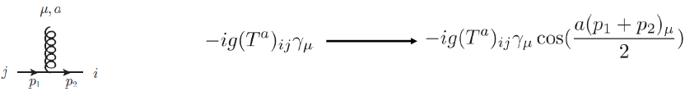

Lattice perturbation theory
Feynman rules (Feynman gauge)
Gluon propagator:
Quark propagator:
Quark-Gluon vertex:
Quark-Two-Gluon vertex:

Slide 36

Discretized quasi-PDFs
Quasi-quark distribution:
Discretized operator is not unique!
Simplest case:

Slide 37

Feynman diagrams in lattice PT

Slide 38

Infrared Safe
Calculation in coordinate space:
IR cancelation:
Cancelation of soft divergence is manifested in Feynman gauge!

Slide 39



Calculation technique
H. Kawai, Nucl. Phys. B189 (1981)40
S. Capitani, Phys. Rept. 382(2003)113

Slide 40

Preliminary result from lattice PT
Same collinear divergence as that calculated in Minkovski space

Slide 41
Summary and outlook
“lattice cross sections” = hadronic matrix elements
calculable in Lattice QCD and factorizable in QCD
Key difference from Ji’s idea:
Expansion in 1/μ instead of that in 1/P_{z}
Extract PDFs by global analysis of data on “Lattice cross sections”. Same should work for other distributions
Conservation of difficulties – complementarity:
High energy scattering experiments
– less sensitive to large x parton distribution/correlation
“Lattice factorizable cross sections”
– more suited for large x partons
Lattice QCD can calculate PDFs, but, more works are needed!
Thank you!

Slide 42
Backup slides

Slide 43
Quantum Chromodynamics (QCD)
A quantum field theory of quarks and gluons
Fields:
Quark fields: spin-½ Dirac fermion (like electron)
Color triplet:
Flavor:
Gluon fields: spin-1 vector field (like photon)
Color octet:
QCD Lagrangian density:
QED Lagrangian density – force to hold atoms together:
QCD is much richer in dynamics than QED
Gluons are dark, but, interact with themselves, NO free quarks and gluons

