Slide 1
Universality in W+Jet Production
David A. Kosower
Institut de Physique Théorique, CEA–Saclay
on behalf of the BlackHat Collaboration
Z. Bern, L. Dixon, Fernando Febres Cordero, Stefan Höche, Harald Ita, DAK, Adriano Lo Presti, Daniel Maître, Kemal Ozeren
[0907.1984, 1009.2338, 1108.2229, 1304.1253, 1308.3986 & work in progress]
Beijing University
May 29, 2014

Slide 2
Vector+Jets
Background to
  Many searches of new physics
  Measurements of Higgs properties
  Measurements of top properties
Standard candle for checking our understanding of Standard-Model processes

Slide 3
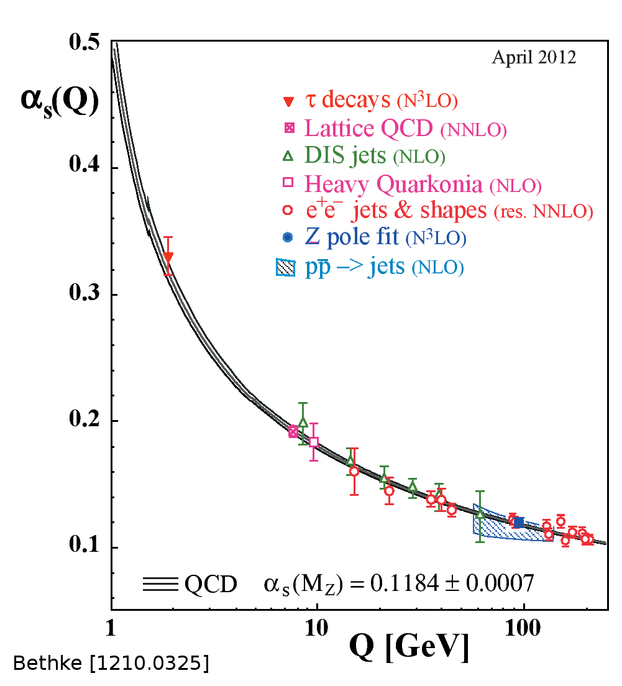
The Challenge
Strong coupling is not small: α_{s}(M_{Z}) ≈ 0.12 and running is important
  events have high multiplicity of hard clusters (jets)
  each jet has a high multiplicity of hadrons
  higher-order perturbative corrections are important
Processes can involve multiple scales: p_{T}(W) & M_{W}
  need resummation of logarithms
Confinement introduces further issues of mapping partons to hadrons, but for suitably-averaged quantities (infrared-safe) avoiding small E scales, this is not a problem (power corrections)

Slide 4
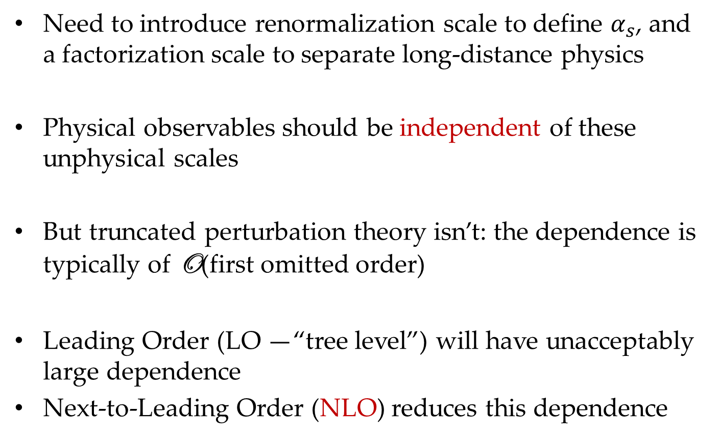
What’s the Right Scale?
Need to introduce renormalization scale to define $α_{s}$, and a factorization scale to separate long-distance physics
Physical observables should be independent of these unphysical scales
But truncated perturbation theory isn’t: the dependence is typically of O(first omitted order)
Leading Order (LO —“tree level”) will have unacceptably large dependence
Next-to-Leading Order (NLO) reduces this dependence

Slide 5
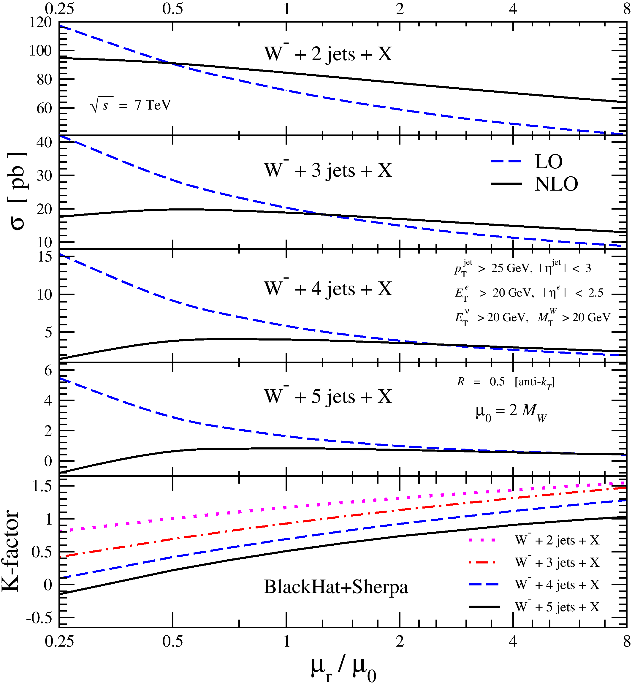
NLO with Many Jets
NLO: reduced scale dependence
as expected
NLO importance grows with
increasing number of jets
Applications to Multi-Jet Processes:
  Measurements of Standard-Model
  distributions & cross sections
  Estimating backgrounds in
  searches
Expect predictions reliable
to 10–15%
<5% predictions will require NNLO

Slide 6
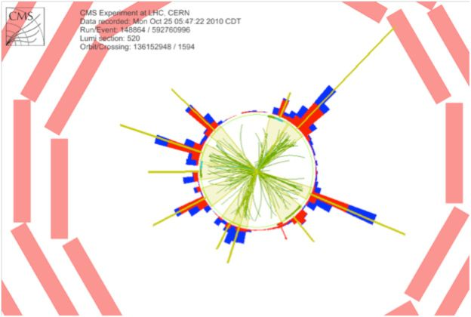
A CMS 10-Jet Event

Slide 7
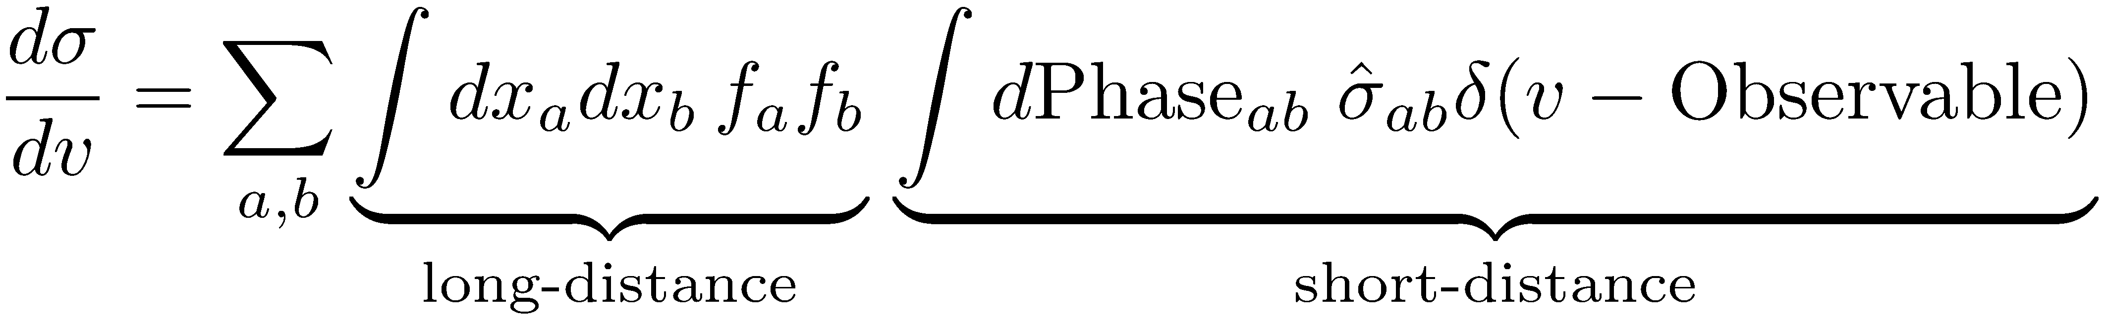
QCD-Improved Parton Model
Parton-hadron duality
p
p

Slide 8



Ingredients for NLO Calculations
Tree-level matrix elements for LO and real-emission terms
known since ’80s ✓
…but we’ve improved efficiency since then (CSW, BCFW)
Singular (soft & collinear) behavior of tree-level amplitudes, integrals, initial-state collinear behavior known since ’90s ✓
NLO parton distributions (MSTW,CTEQ,NNPDF,…) continually refined since ’90s ✓
General framework for numerical programs known since ’90s ✓
Catani, Seymour (1996); Giele, Glover, DAK (1993); Frixione, Kunszt, Signer (1995)
Automating real—virtual cancellation for general processes
Gleisberg, Krauss; Seymour, Tevlin; Hasegawa, Moch, Uwer; Frederix, Gehrmann, Greiner (2008); Frederix, Frixione, Maltoni, Stelzer (2009)
On-shell Methods: one-loop amplitudes
W+2 jets (MCFM) → W+3 jets → W+4 jets → W+5 jets →
Bern, Dixon, DAK, Weinzierl (1997–8); BlackHat; BlackHat
Campbell, Glover, Miller (1997) Rocket
Bottleneck: one-loop amplitudes

Slide 9
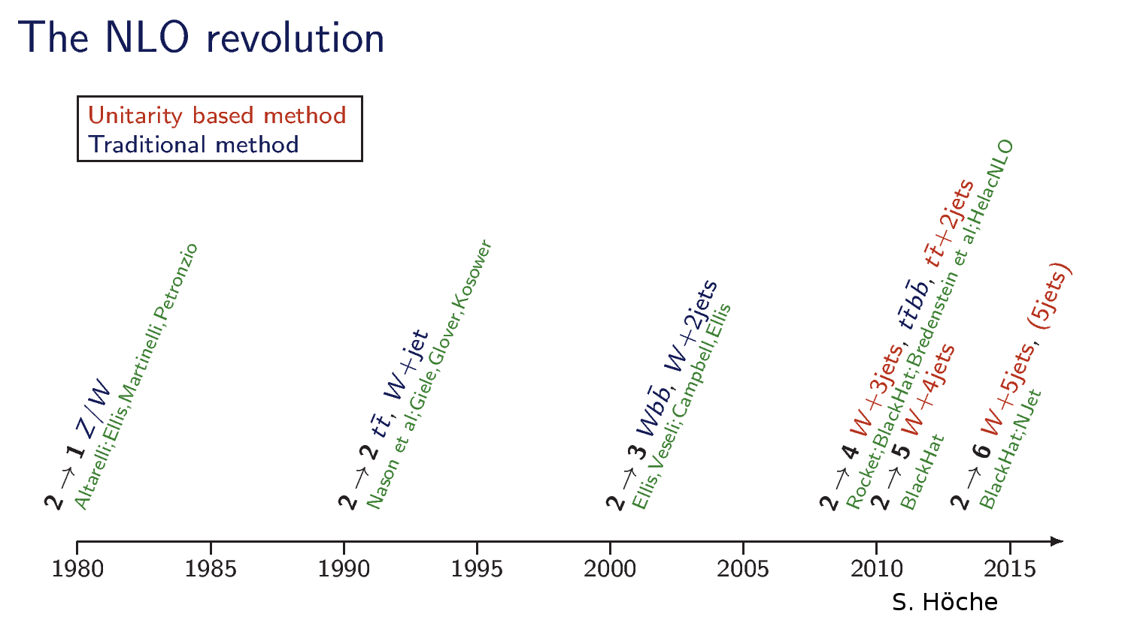

Slide 10




On-Shell Methods
Formalism
Rational function of spinors
Known integral basis:
On-shell Recursion;
D-dimensional unitarity
via ∫ mass
Unitarity in D = 4

Slide 11

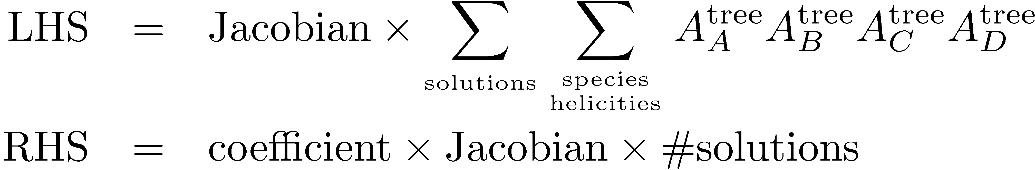
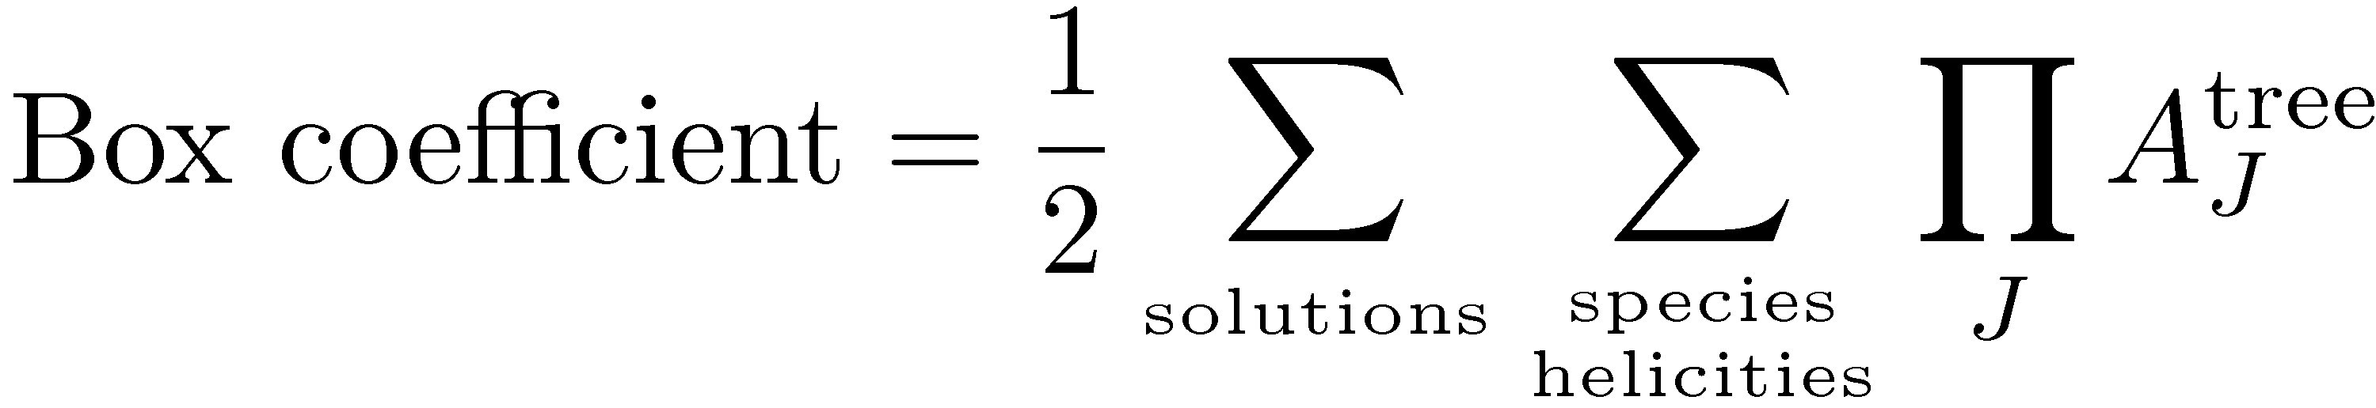
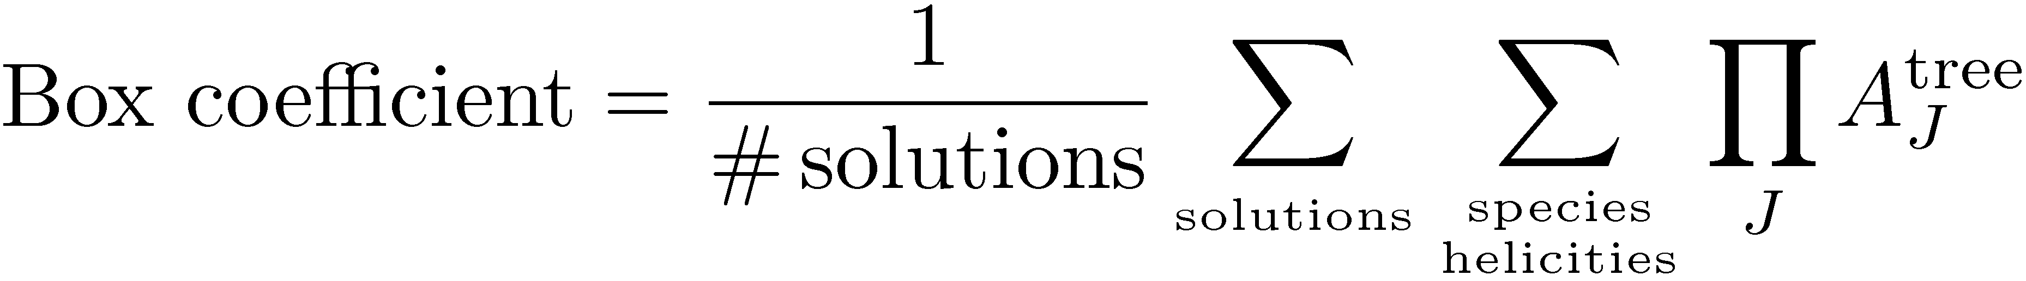
Box Coefficient
A
B
Apply quadruple cuts to both sides of
master equation
Solve:
Britto, Cachazo, Feng
No algebraic reductions needed: suitable for pure numerics
D
C

Slide 12

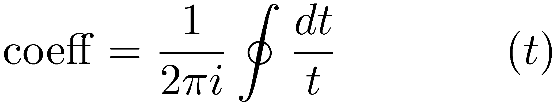
Triangle Cuts
  Unitarity leaves one degree of freedom in triangle integrals.
  Coefficients are the residues at ∞ Forde (2007)
  Jacobian produces global pole
  Discrete Fourier Sum after Ossola–Papadopoulos–Pittau-style subtractions
2
1
3

Slide 13

BlackHat
A software library and its eponymous collaboration
Berger, Bern, Diana, Dixon, Forde, Febres Cordero, Gleisberg, Höche, Ita, DAK, Lo Presti, Maître, Ozeren
Numerical implementation of on-shell methods for one-loop amplitudes
Automated implementation ⇒ industrialization
  Basic philosophy: do algebra numerically, analysis symbolically (“analytically”)
  In practice, we do some algebra symbolically as well

Slide 14
BlackHat + SHERPA
SHERPA
  Process Management
  Phase-space integration
COMIX
  Born + real-emission matrix elements
  Catani–Seymour subtraction terms
BlackHat
  One-loop matrix elements
  Numerical implementation of unitarity method

Slide 15

Running NLO codes
Choose renormalization/factorization scales (IRC-safe function of parton momenta)
Choose PDF set (or element within an error set)
Choose observable(s)
Run code

Slide 16
Running at High Multiplicity
Managing a high-multiplicity computation is complicated
  Many different contributions with wide dynamic range
  Split up into parts of different significance to compute with different statistics
  Many pieces to baby-sit & combine
  Computationally intensive
Computing matrix elements overwhelmingly dominates computation time at given scale
Computing new observables is cheap
Varying μ_{R}, μ_{F} also cheap once terms within matrix element are known
Likewise for choice of parton distributions

Slide 17
n-Tuples
Solution: recycle! Compute matrix elements once, save phase-space configurations with weights & coefficients needed to recompute for different μ_{R}, μ_{F}, PDFs
Save these as ROOT n-tuple files
Analyses done with lightweight C++ or ROOT codes

Slide 18
n-Tuples
Bonus: distribute these to experimenters, who can do their own analyses
Only real restriction is to preselected set of jet algorithms
Jet, lepton/photon p_{T}, rapidity cuts can be tightened
PDFs, scales can be chosen differently
Now available publicly for W,Z+≤4 jets, QCD ≤4 jets, γγ+2 jets (std & VBF)

Slide 19
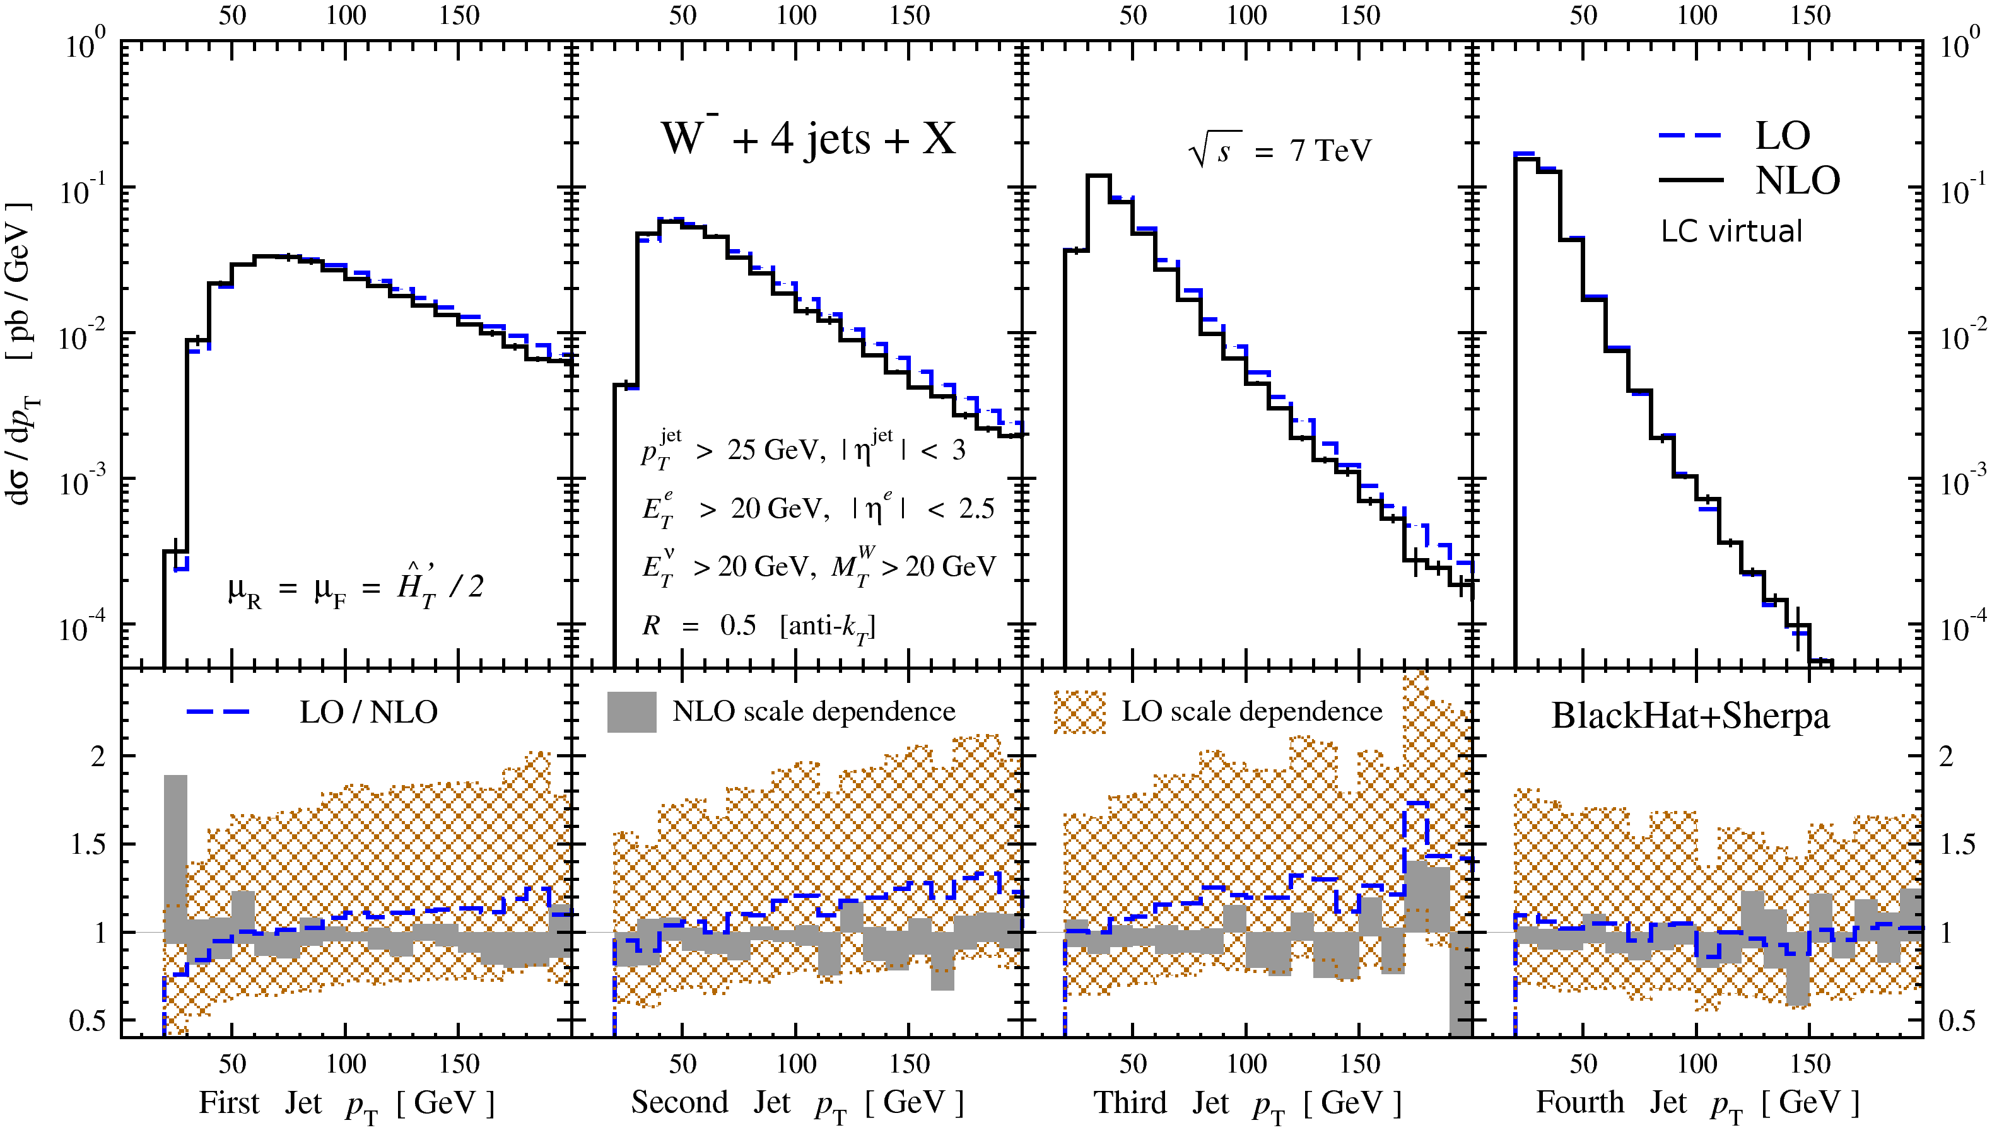
W+4 Jets
Scale variation reduced substantially at NLO
Successive jet distributions fall more steeply
Shapes of 4th jet distribution unchanged at NLO — but first three are slightly steeper

Slide 20
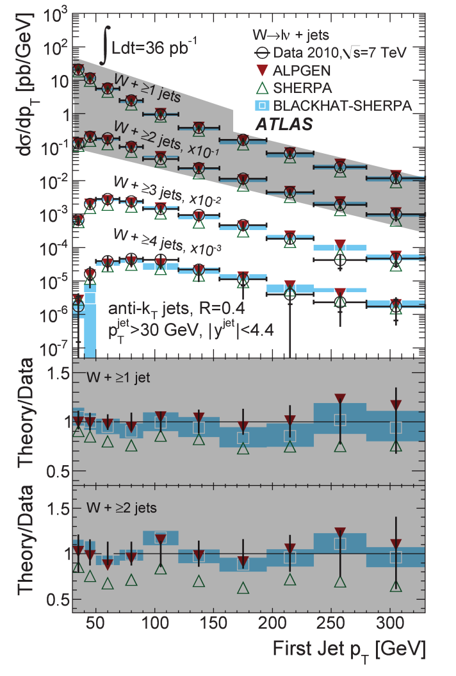
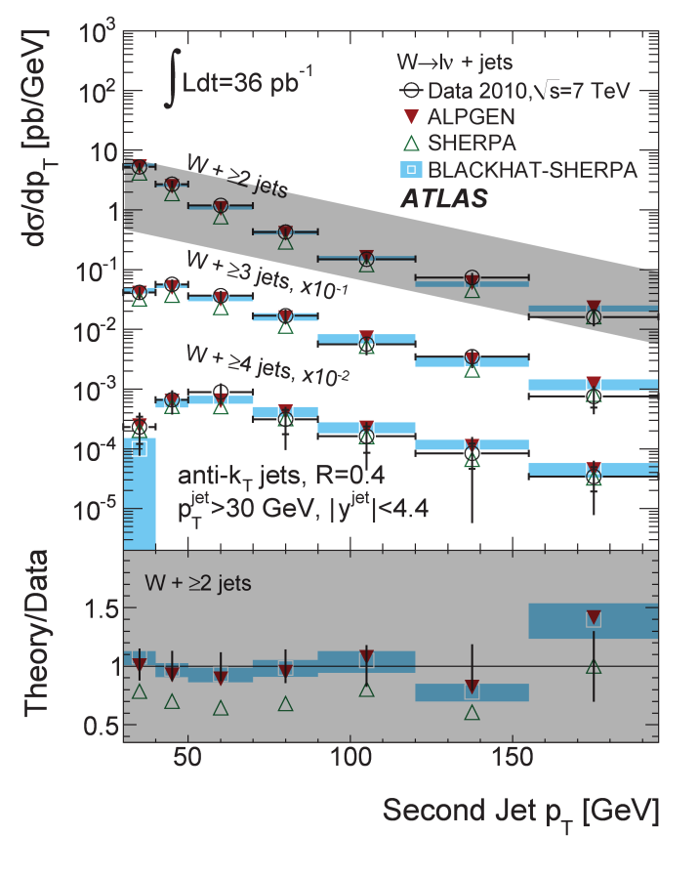
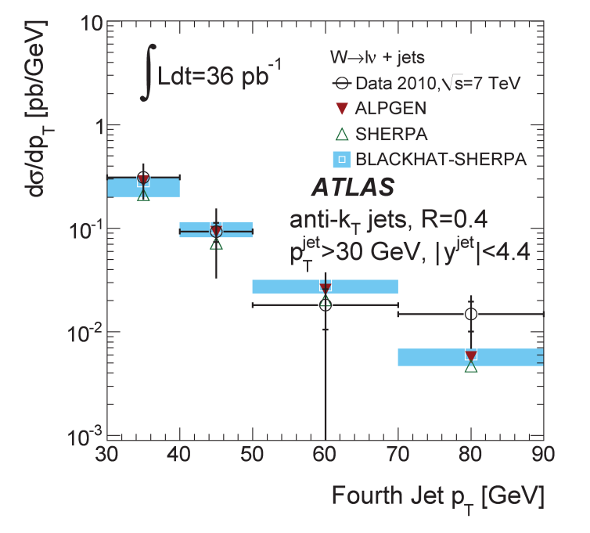
Comparisons to Atlas data 36 pb⁻¹ [1201.1276]

Slide 21
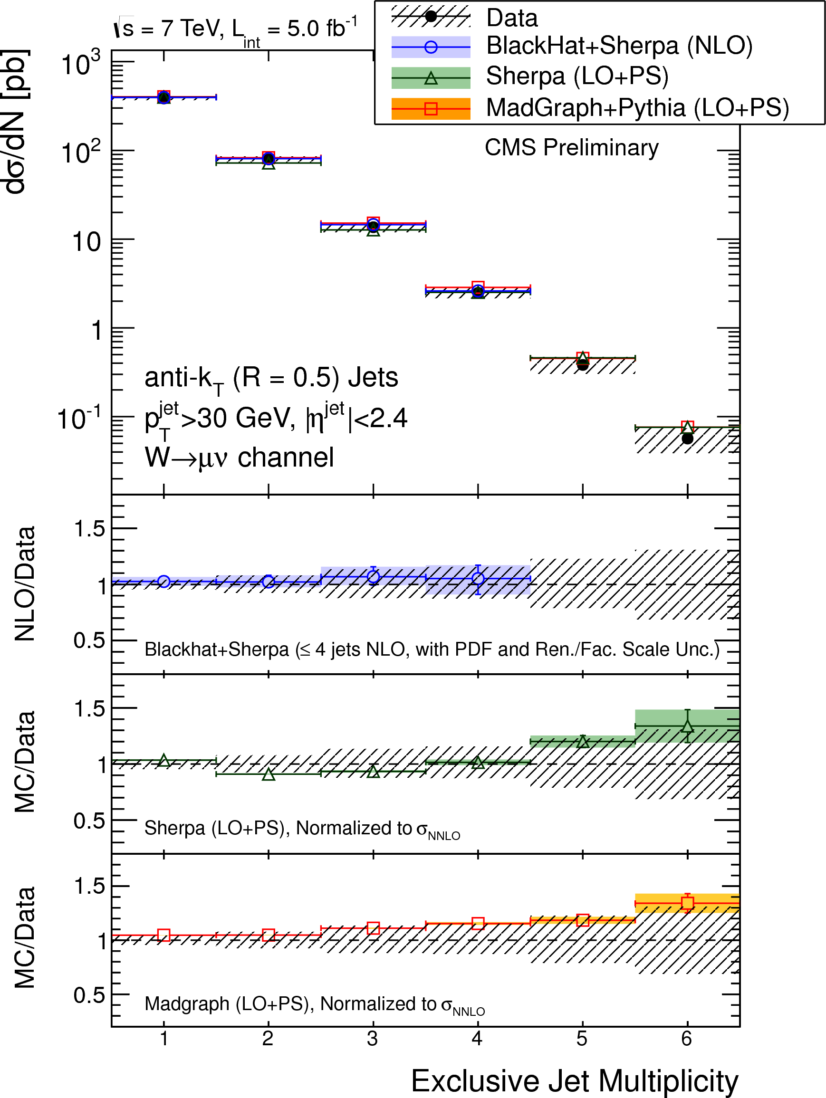
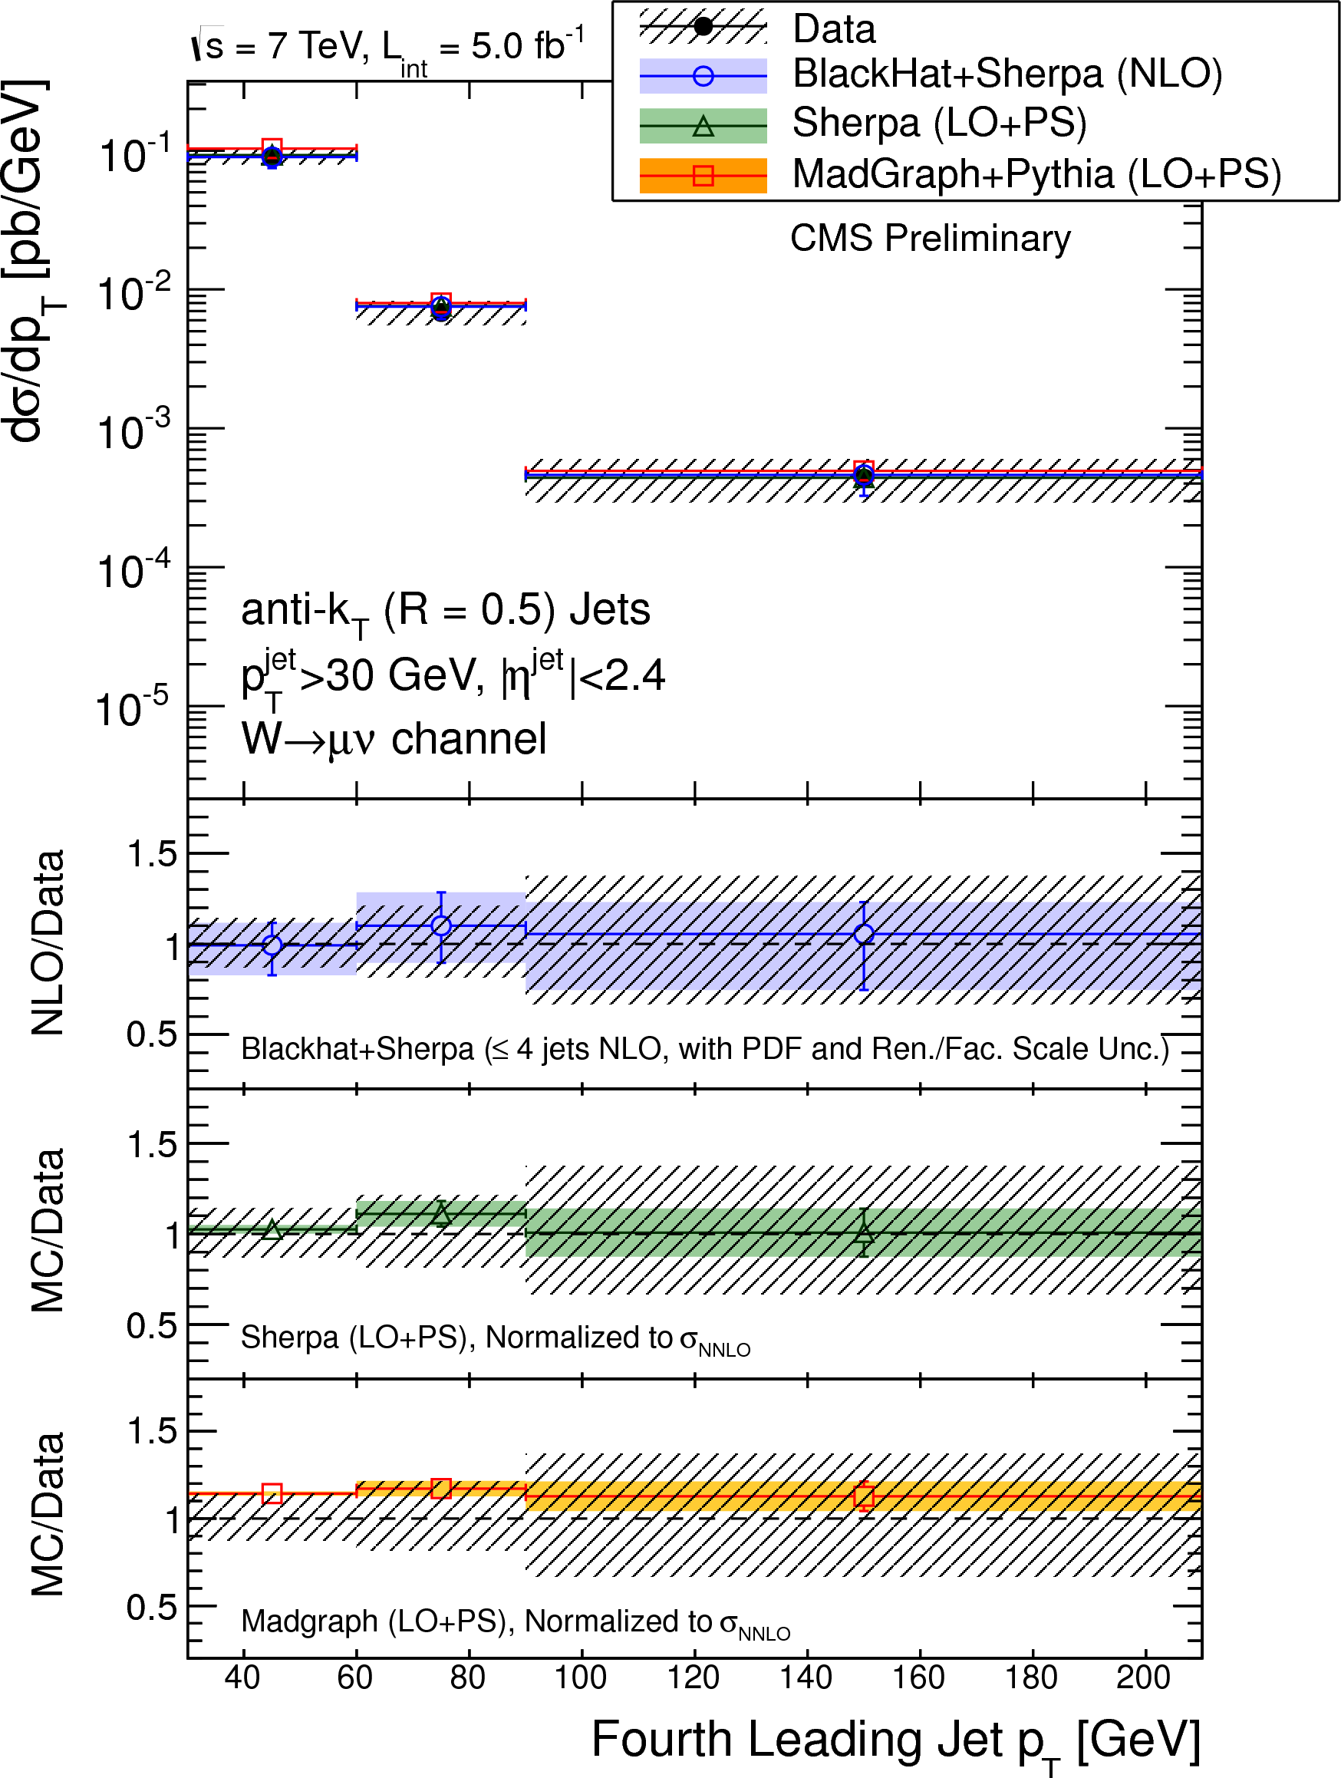
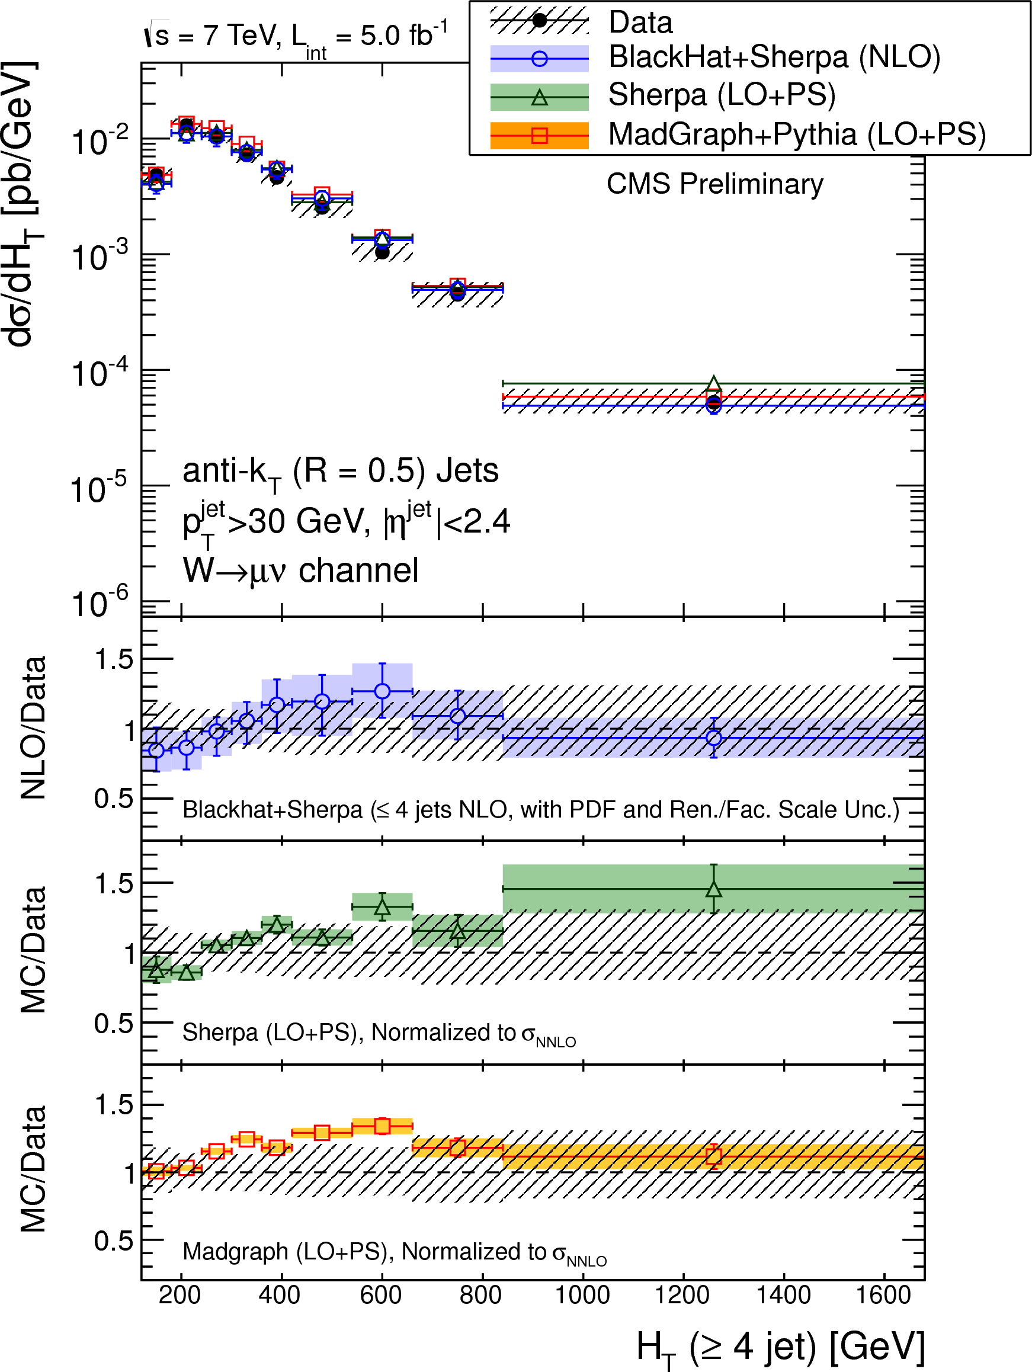
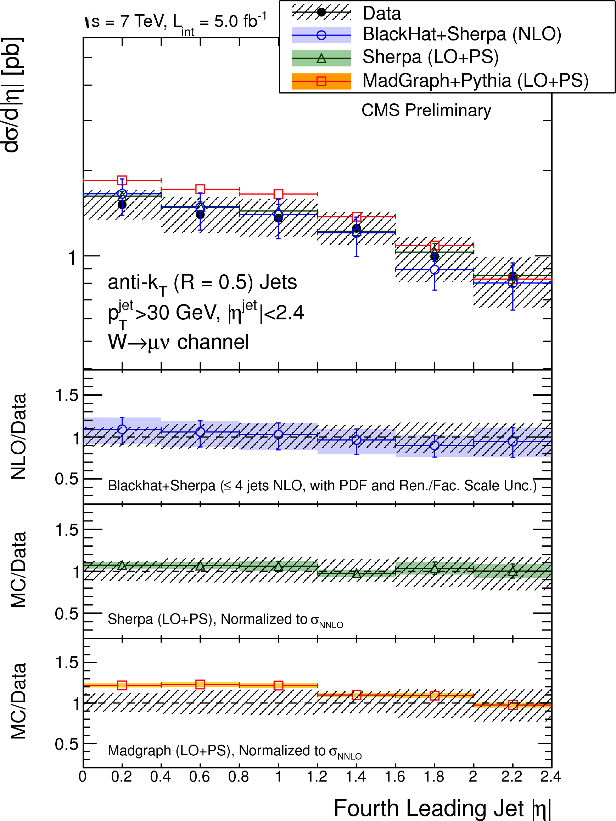
7 TeV results from CMS (March 2014)

Slide 22
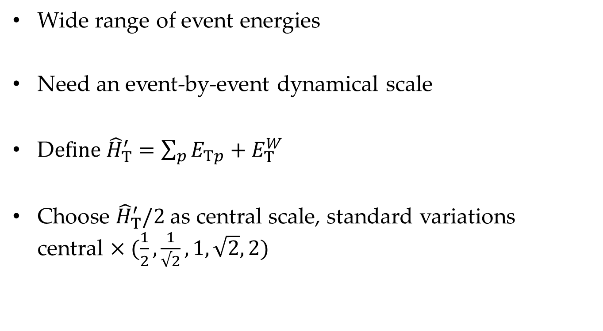
Choosing Scales
Wide range of event energies
Need an event-by-event dynamical scale
D$efine {\hat{H}}_{T}^{′}=\sum_{p}{E_{Tp}+E_{T}^{W}}$
Choose ${\hat{H}}_{T}^{′}/2$ as central scale, standard variations
central $×(\frac{1}{2},\frac{1}{√2},1,\sqrt{2},2)$

Slide 23
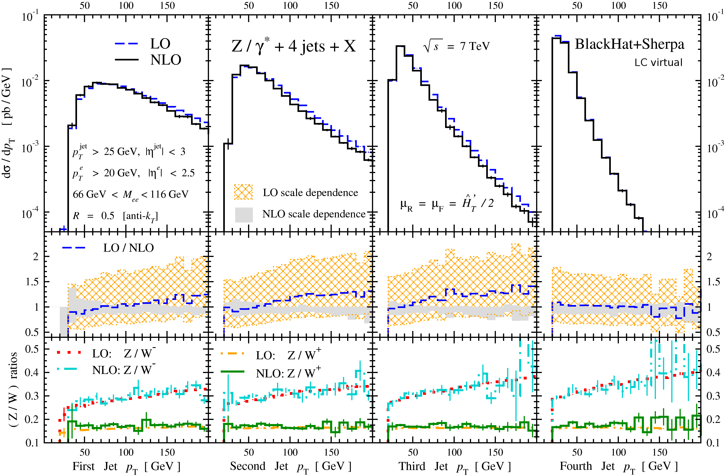
Z+4 Jets
Distributions very similar to W+4 jets
Ratios to W± have small corrections
Overall shapes of ratios determined by x dependence of u/d ratios

Slide 24
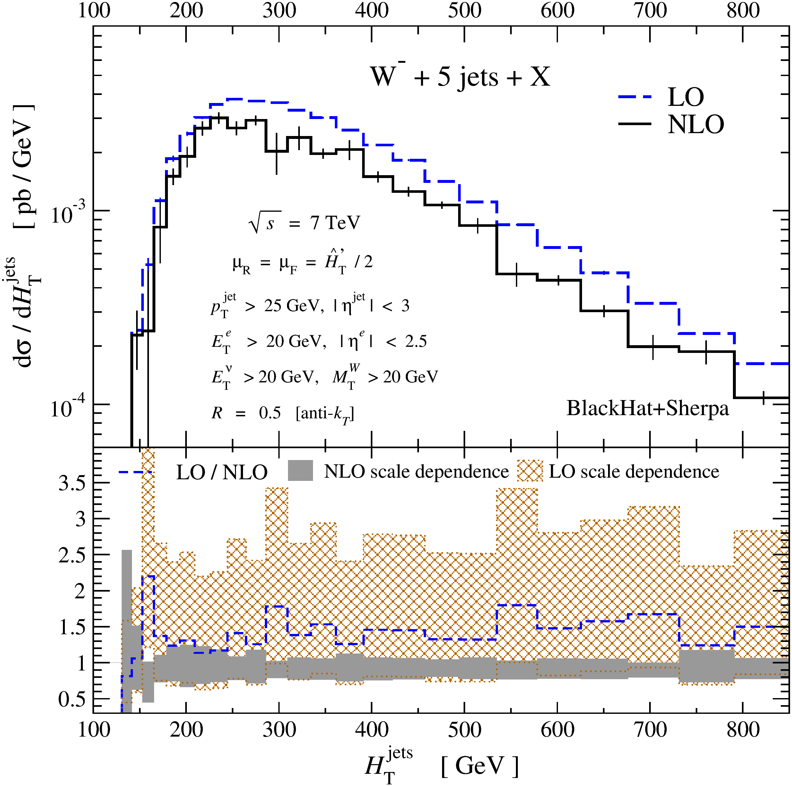
W+5 Jets
Scale dependence narrows substantially at NLO

Slide 25
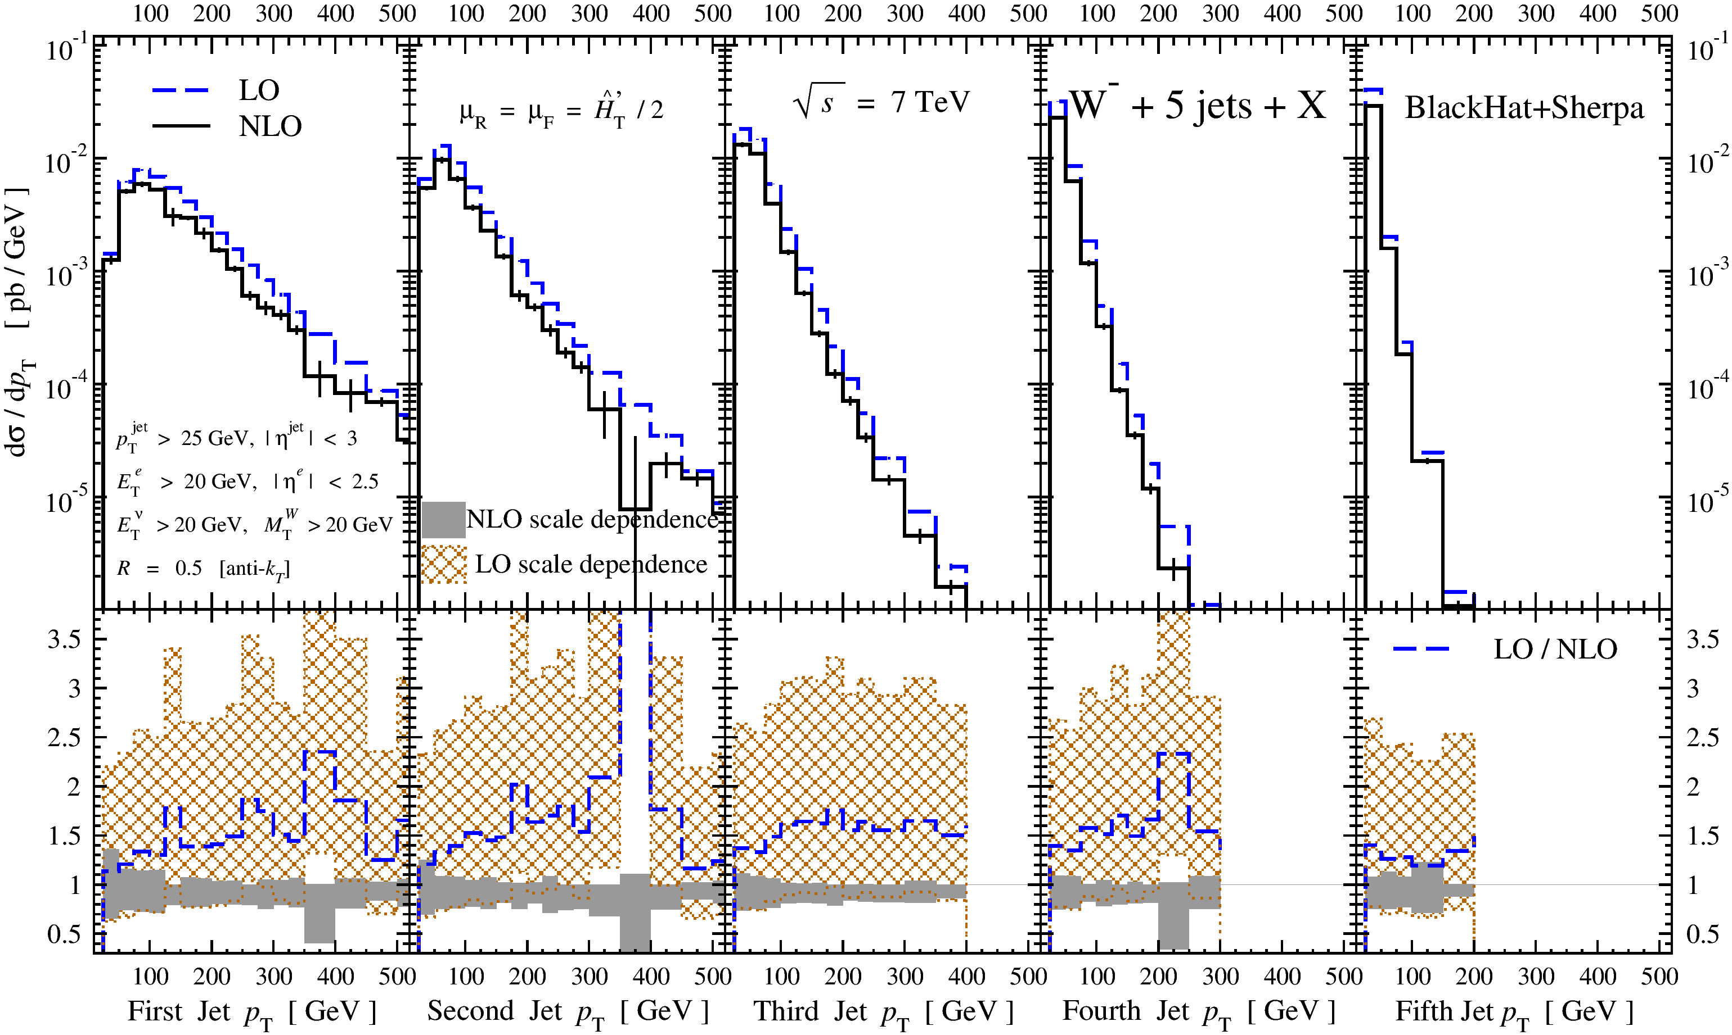
W+5 Jets
Scale-uncertainty bands shrink dramatically
Last jet shape is stable, harder jets have steeper spectrum at NLO

Slide 26
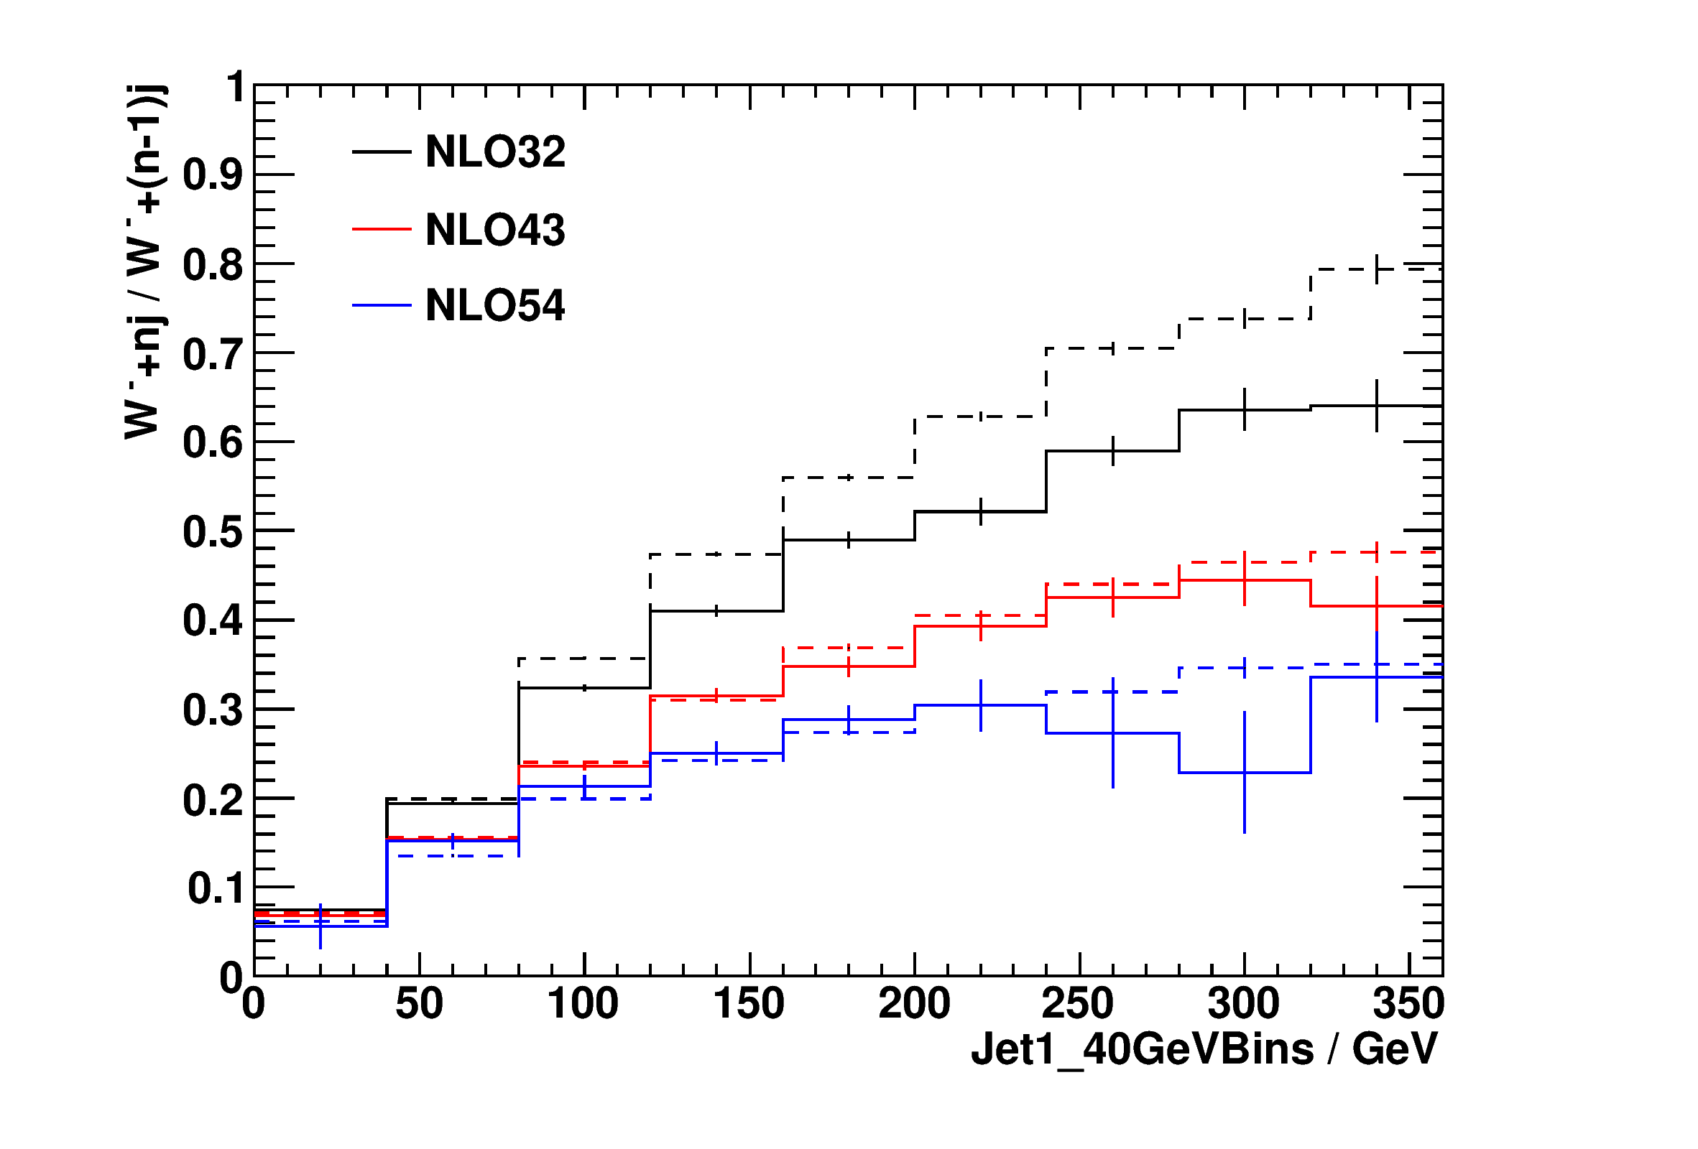
Jet-Production Ratios
Ratios reduce uncertainties both in experiment and theory
Relaxation of kinematic restrictions leads to NLO corrections at large p_{T} in V+3/V+2, otherwise stable
Ratio is not constant as a function of p_{T}

Slide 27
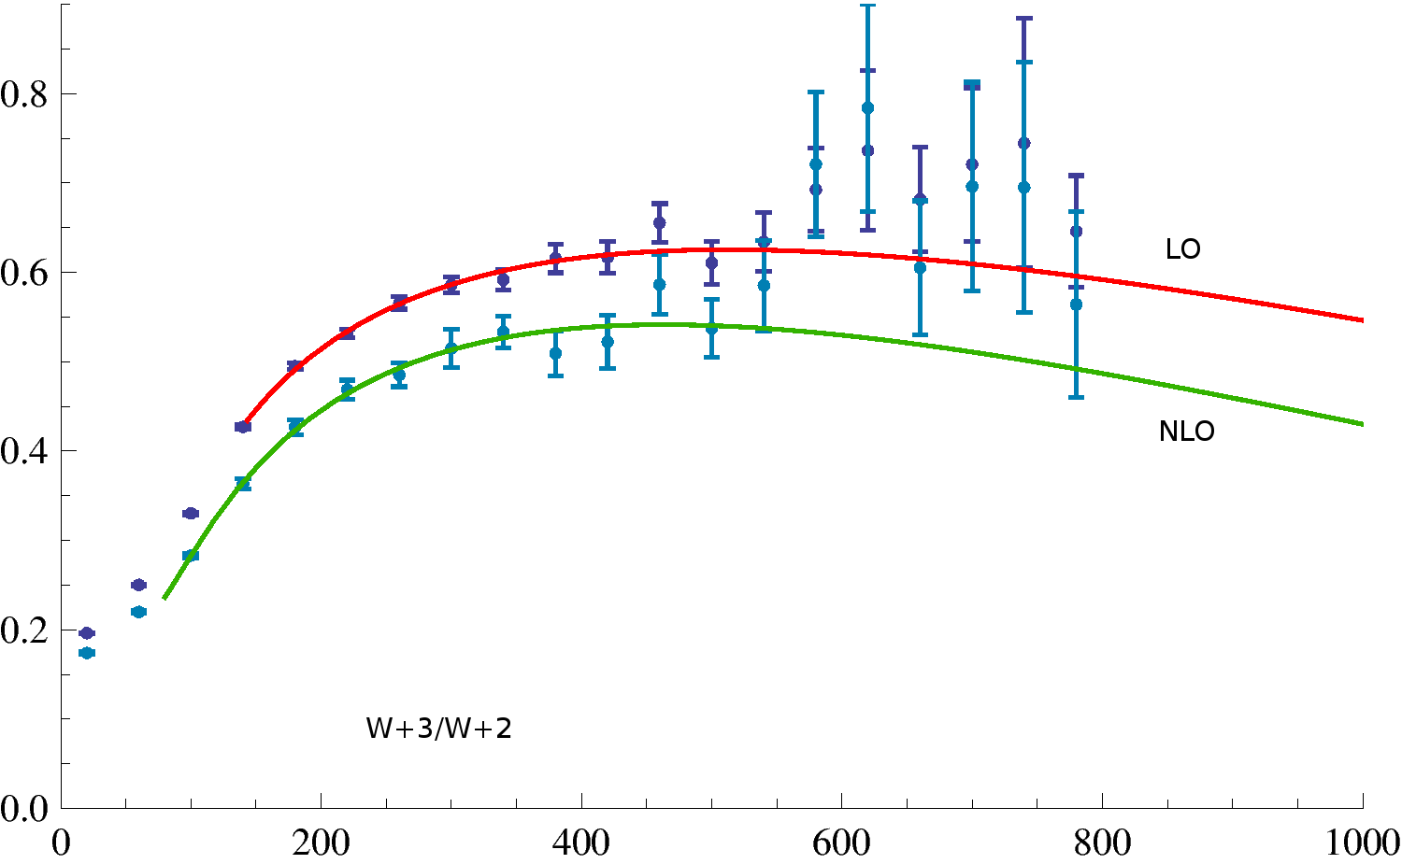
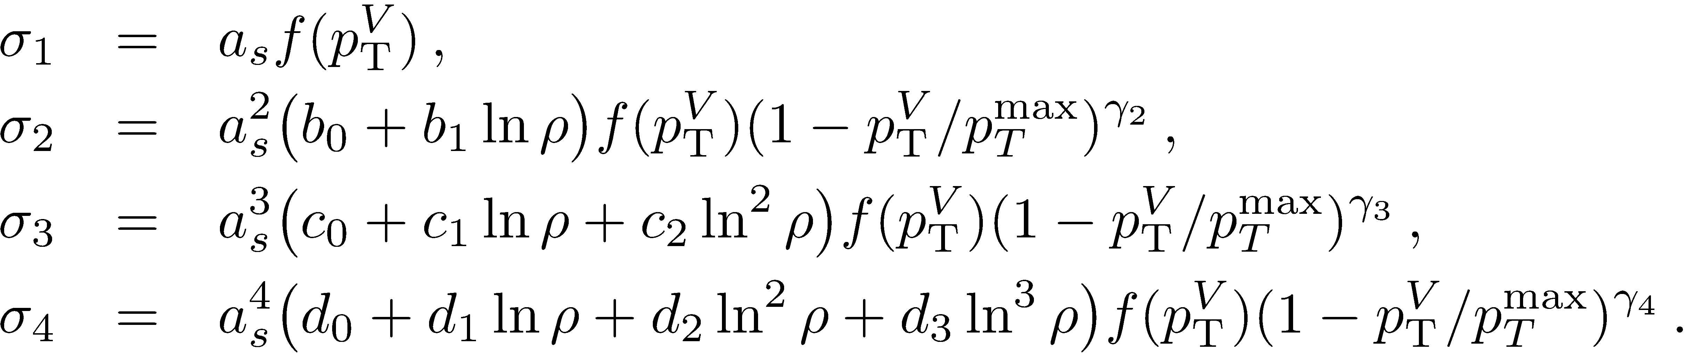
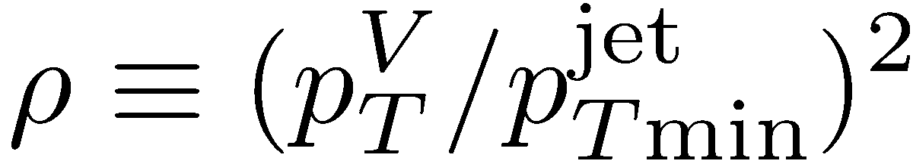

W⁻+Jet Ratios
Study W ⁻+n-jet/W ⁻+(n−1)-jet ratios as a function of $p_{T}^{W}$
Model cross sections as
where
Do the ratios require resummation?

Slide 28
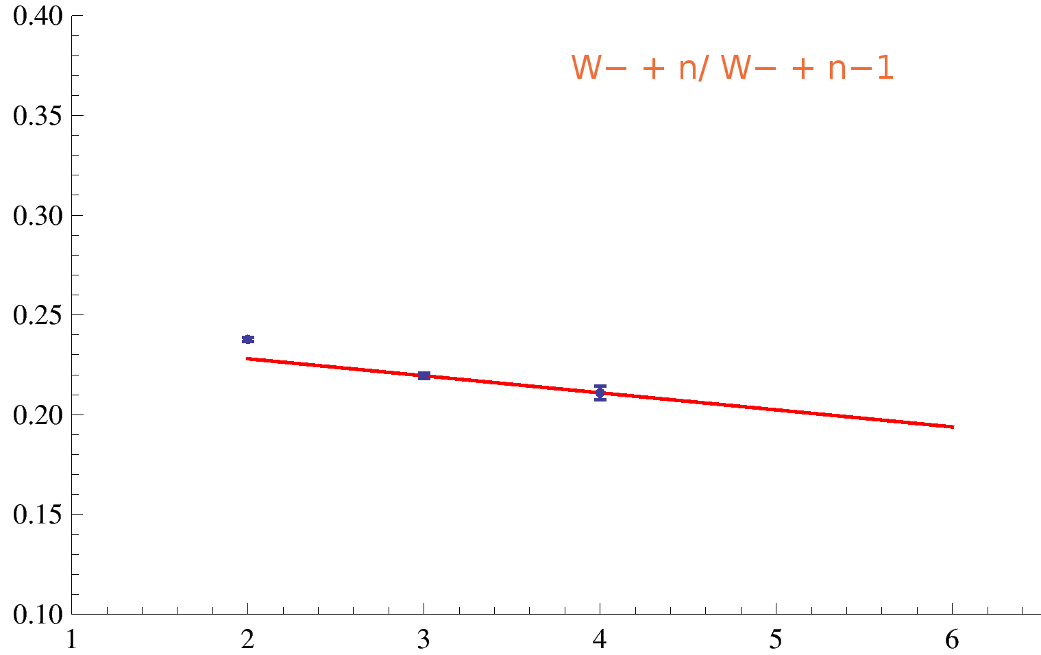
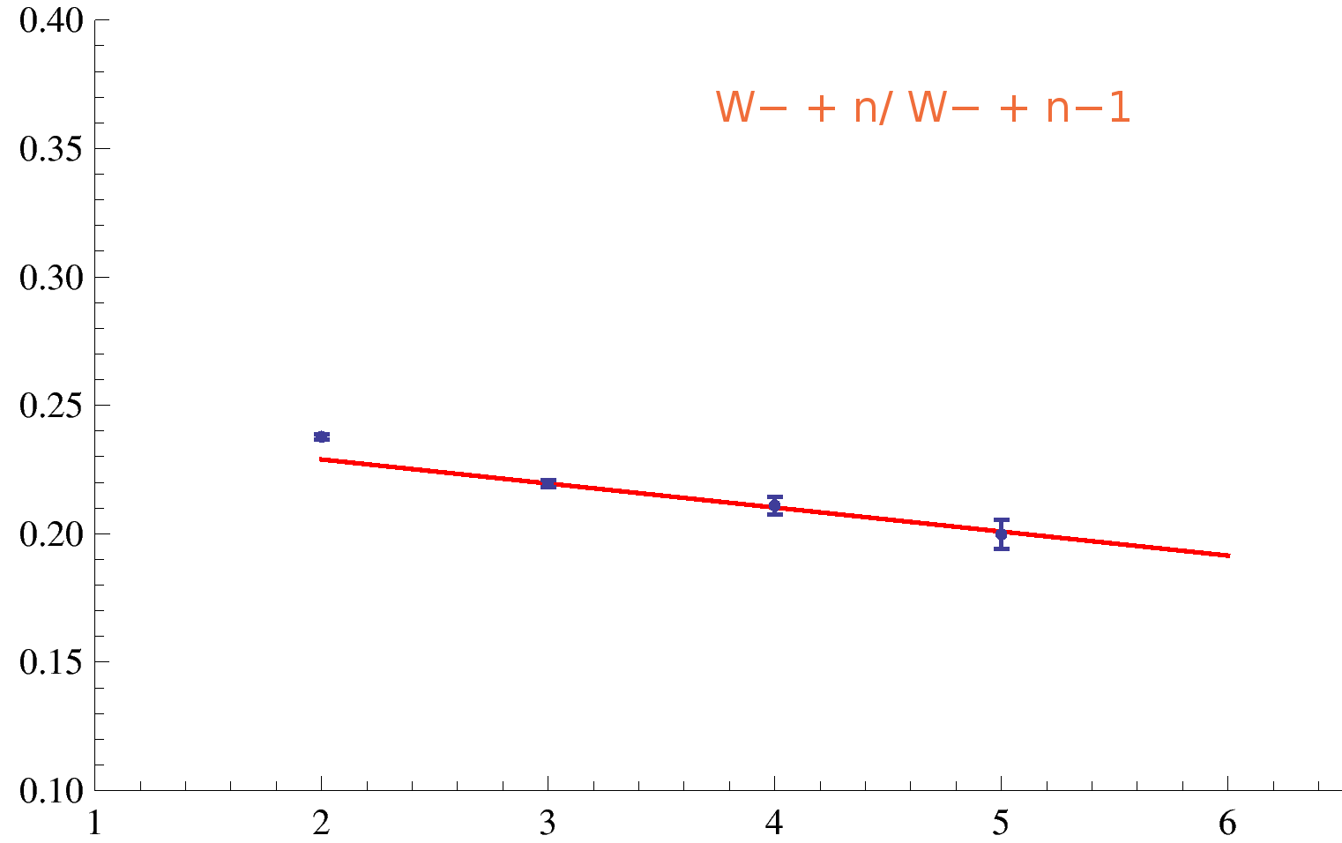
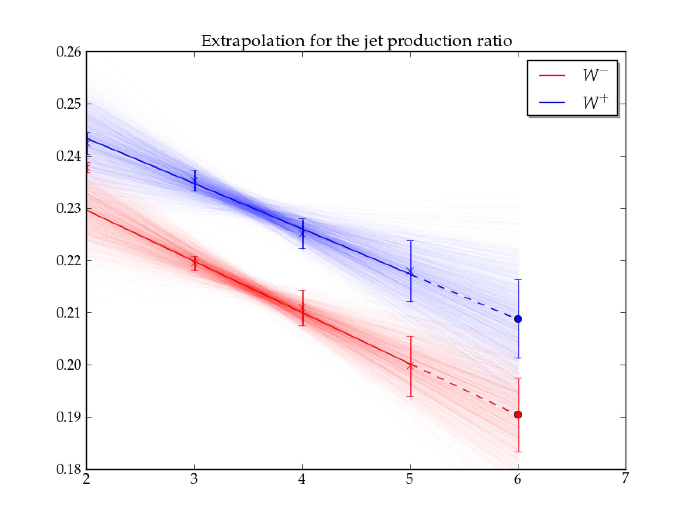
Extrapolations
Let’s try extrapolating ratios to larger n
We know the W+2/W+1 ratio behaves differently from W+n/W+(n−1) ratios, because of kinematic constraints & missing processes (especially at LO)
We could extrapolate from W+4/W+3 & W+3/W+2 — but with two points and two parameters, how meaningful is that?
With the W+5/W+4 ratio, a linear fit (with excellent χ²/dof) makes the extrapolation meaningful:
W⁻ + 6 jets: 0.15 ± 0.01 pb
W⁺ + 6 jets: 0.30 ± 0.03 pb
Uncertainty estimates from Monte-Carlo simulation of synthetic data

Slide 29
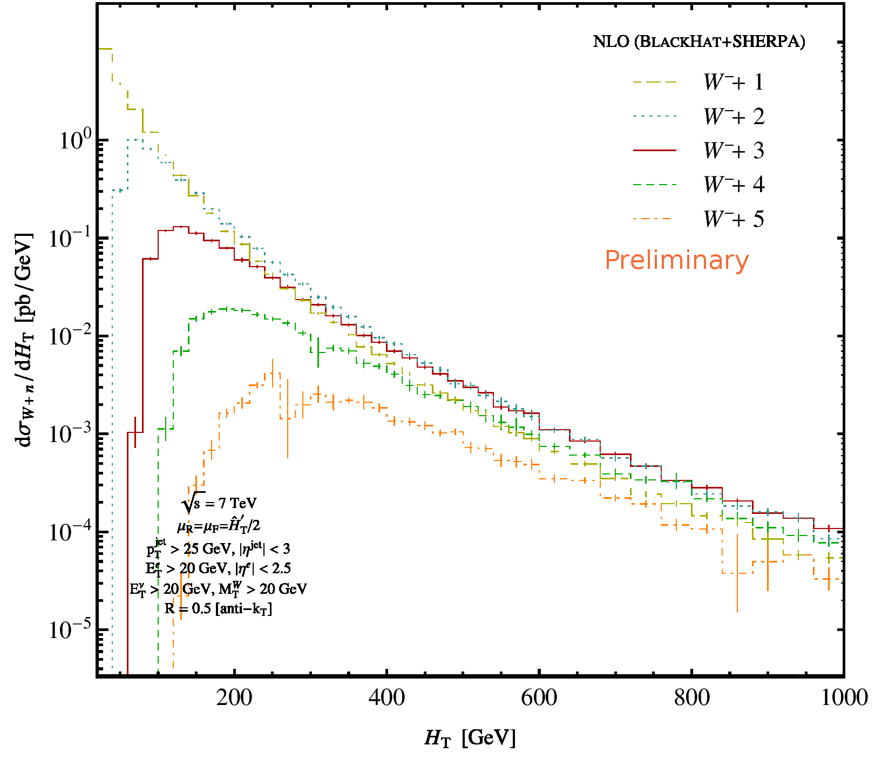

$H_{T}^{jet}$ Distribution
Look at distribution of total transverse energy in jets: good probe into high-p_{T} physics
Let’s try to extrapolate the distribution to W+6 jets
Different peaks
Different thresholds

Slide 30
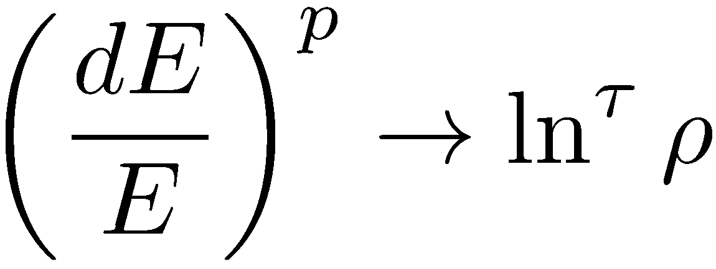
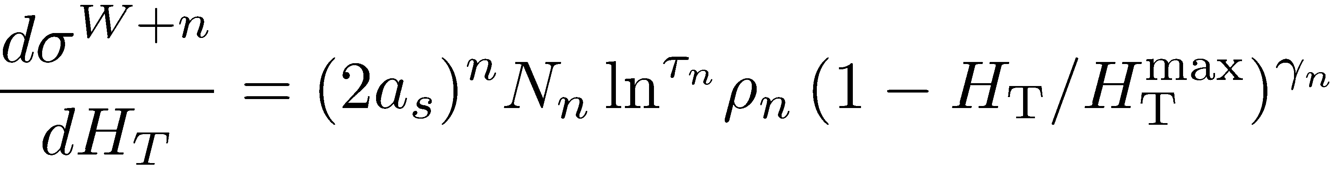
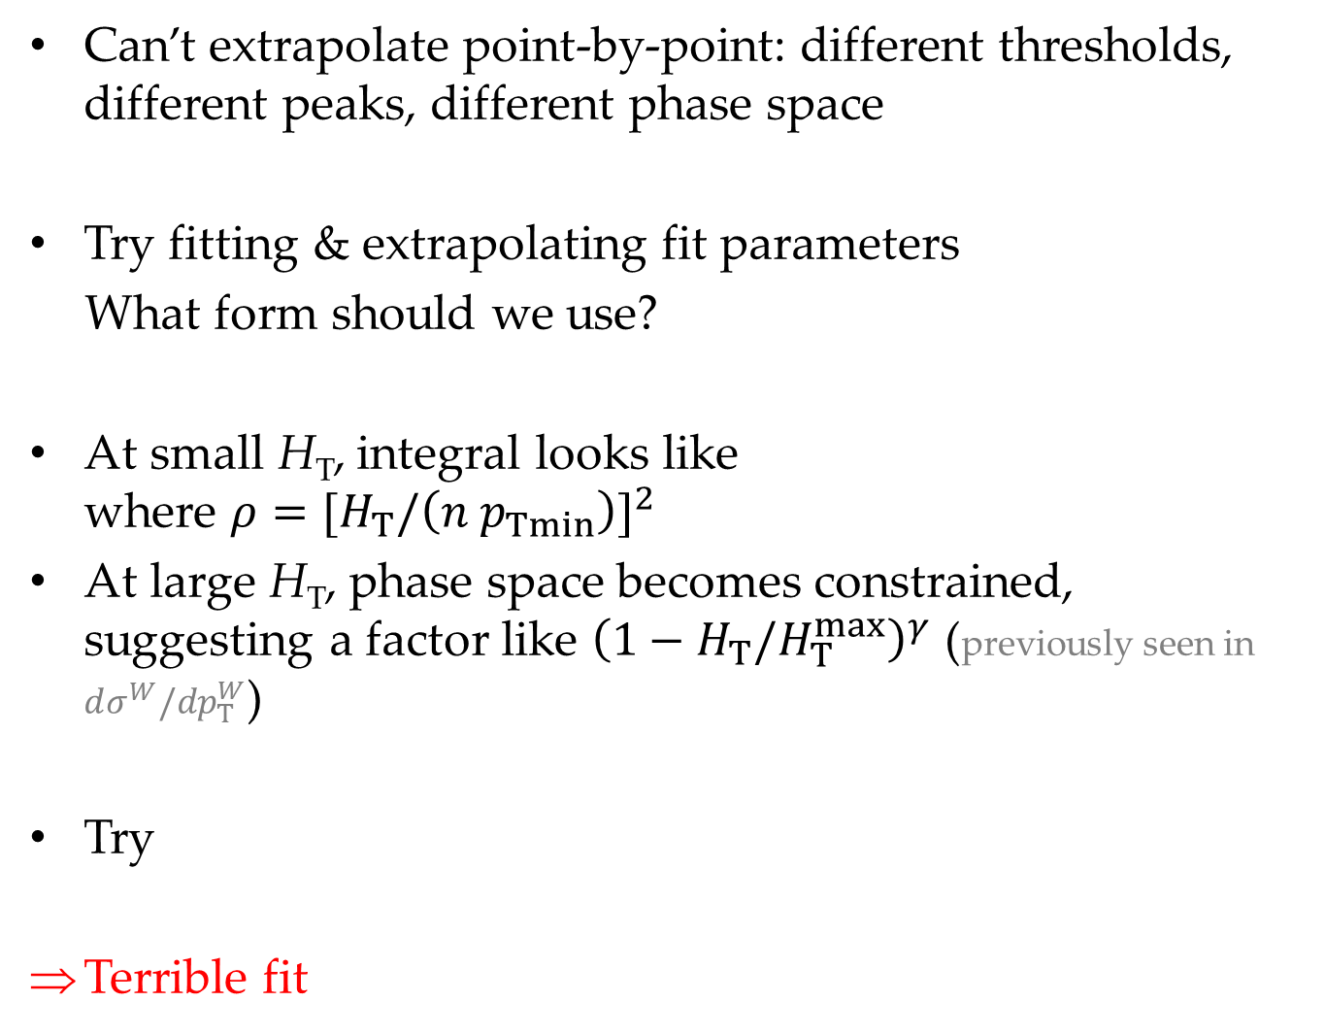
Can’t extrapolate point-by-point: different thresholds, different peaks, different phase space
Try fitting & extrapolating fit parameters
What form should we use?
At small H_{T}, integral looks like
where $ρ={[H}_{T}/{\left(n p_{Tmin}\right)]}^{2}$
At large H_{T}, phase space becomes constrained, suggesting a factor like ${\left(1−H_{T}/H_{T}^{max}\right)}^{γ}$ (previously seen in $dσ^{W}/dp_{T}^{W}$)
Try
Terrible fit

Slide 31
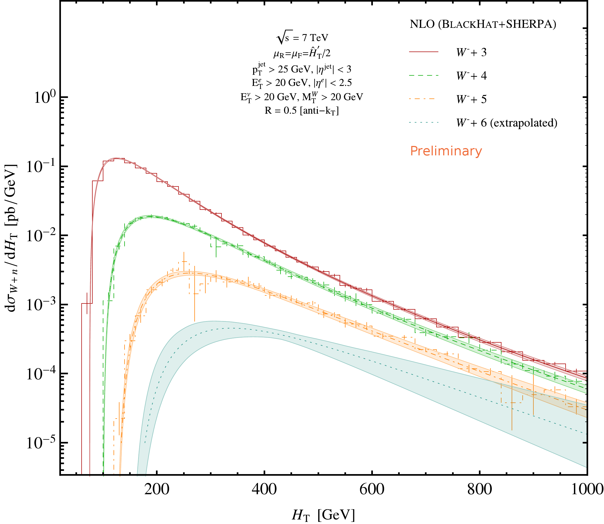

Extrapolating
But for ratios of distributions, this form gives great fits!
Extrapolate $τ, γ$: linear extrapolations work well; fit N to total cross section
Use numerics or fit form (more convenient) for $dσ^{W+2}/dH_{T}$

Slide 32
Summary
Study of an important Standard-Model process at high jet multiplicity: W+4,5 jets
Study of Standard-Model signals in widely-varying kinematic regimes gives confidence in our ability to understand backgrounds quantitatively at high multiplicity
Reliability of ratios, signs of universality for ≥ 3 jets
Extrapolations to W+6 jets

